Slide 1

#RahoAmbitious
TechM Full Stack Software Development

Slide 2




Course: Software Testing
Lecture On: Testing Fundamentals
Instructor: Bibek Prasad

Slide 3

Course Overview
Testing Fundamentals
Selenium WebDriver
UI Automation Testing
Back-End Automation Testing
**Along the course of the project, we will write a test automation script for a food ordering website.

Slide 4

Today’s Agenda
What, Why and How of Software Testing
Different Software Testing Methodologies/Terminologies
Principles of White-Box and Black-Box Testing
Why, What of Test Automation

Slide 5



Poll 1(15 Sec)
What do you understand by the term Software Testing?
(Note: More than one option may be correct)
It is a process to verify whether the results obtained are equal to the expected results.
It helps to identify errors and bugs in the system.
It ensures quality and accuracy of the product.
It helps in improving system performance.
Practice in teams of 4 students
Industry expert mentoring to learn better
Get personalised feedback for improvements
5

Slide 6
Poll 1(Answer)
What do you understand by the term Software Testing?
(Note: More than one option may be correct)
It is a process to verify whether the results obtained are equal to the expected results.
It helps to identify errors and bugs in the system.
It ensures quality and accuracy of the product.
It helps in improving system performance.
Practice in teams of 4 students
Industry expert mentoring to learn better
Get personalised feedback for improvements
6

Slide 7
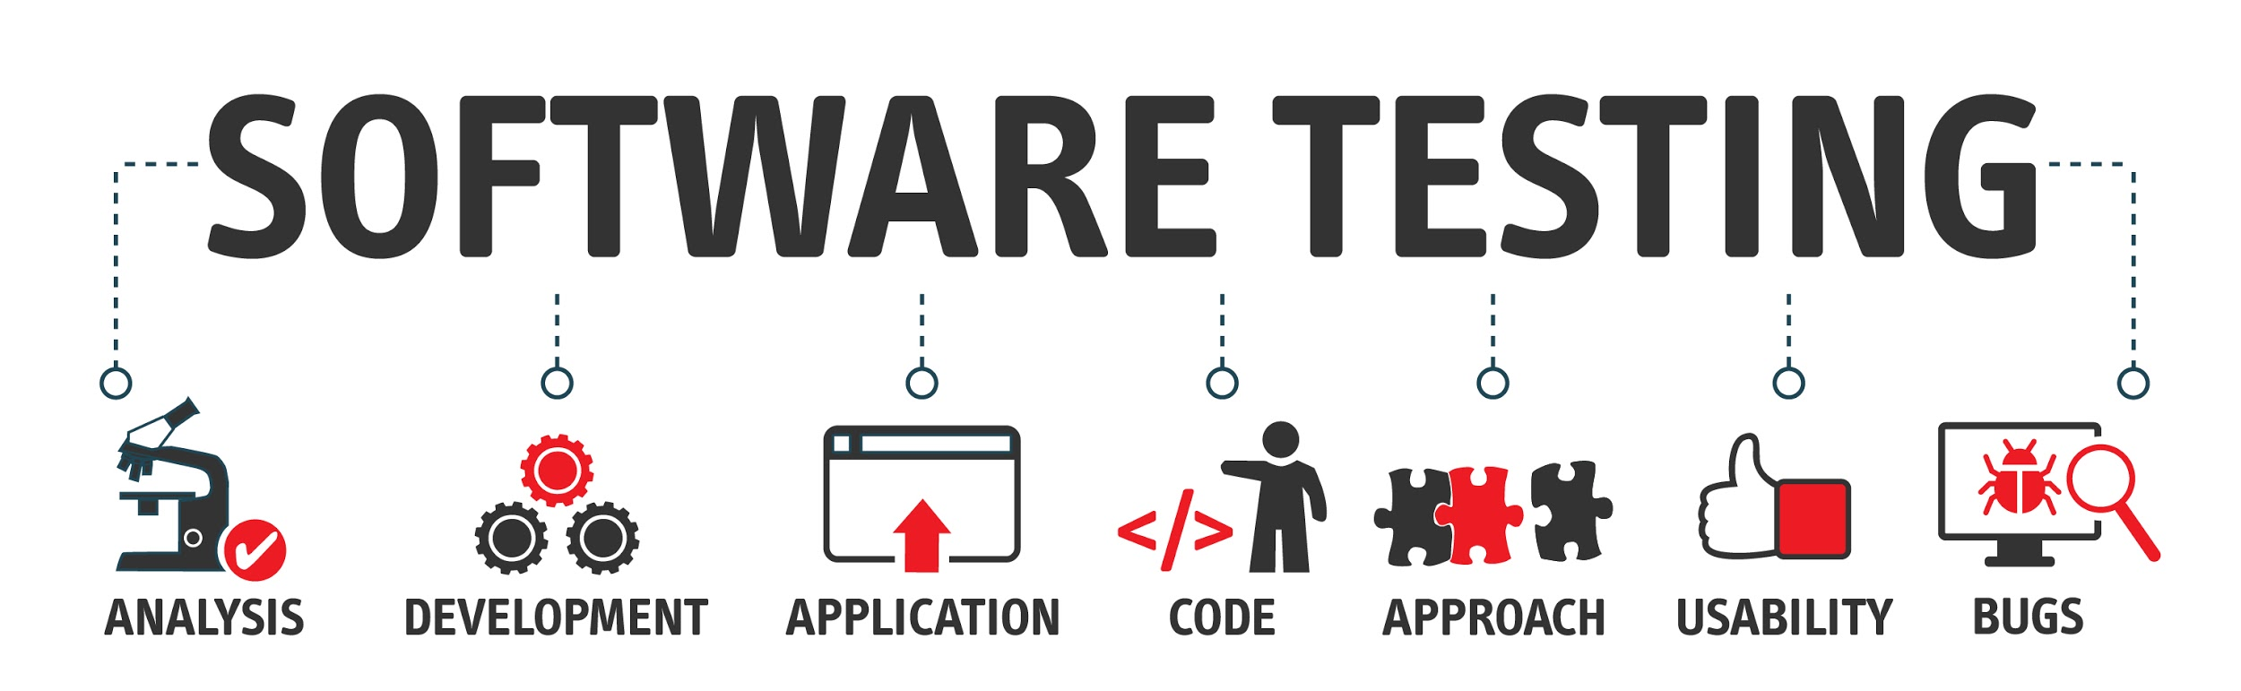
What is Software Testing?

Slide 8
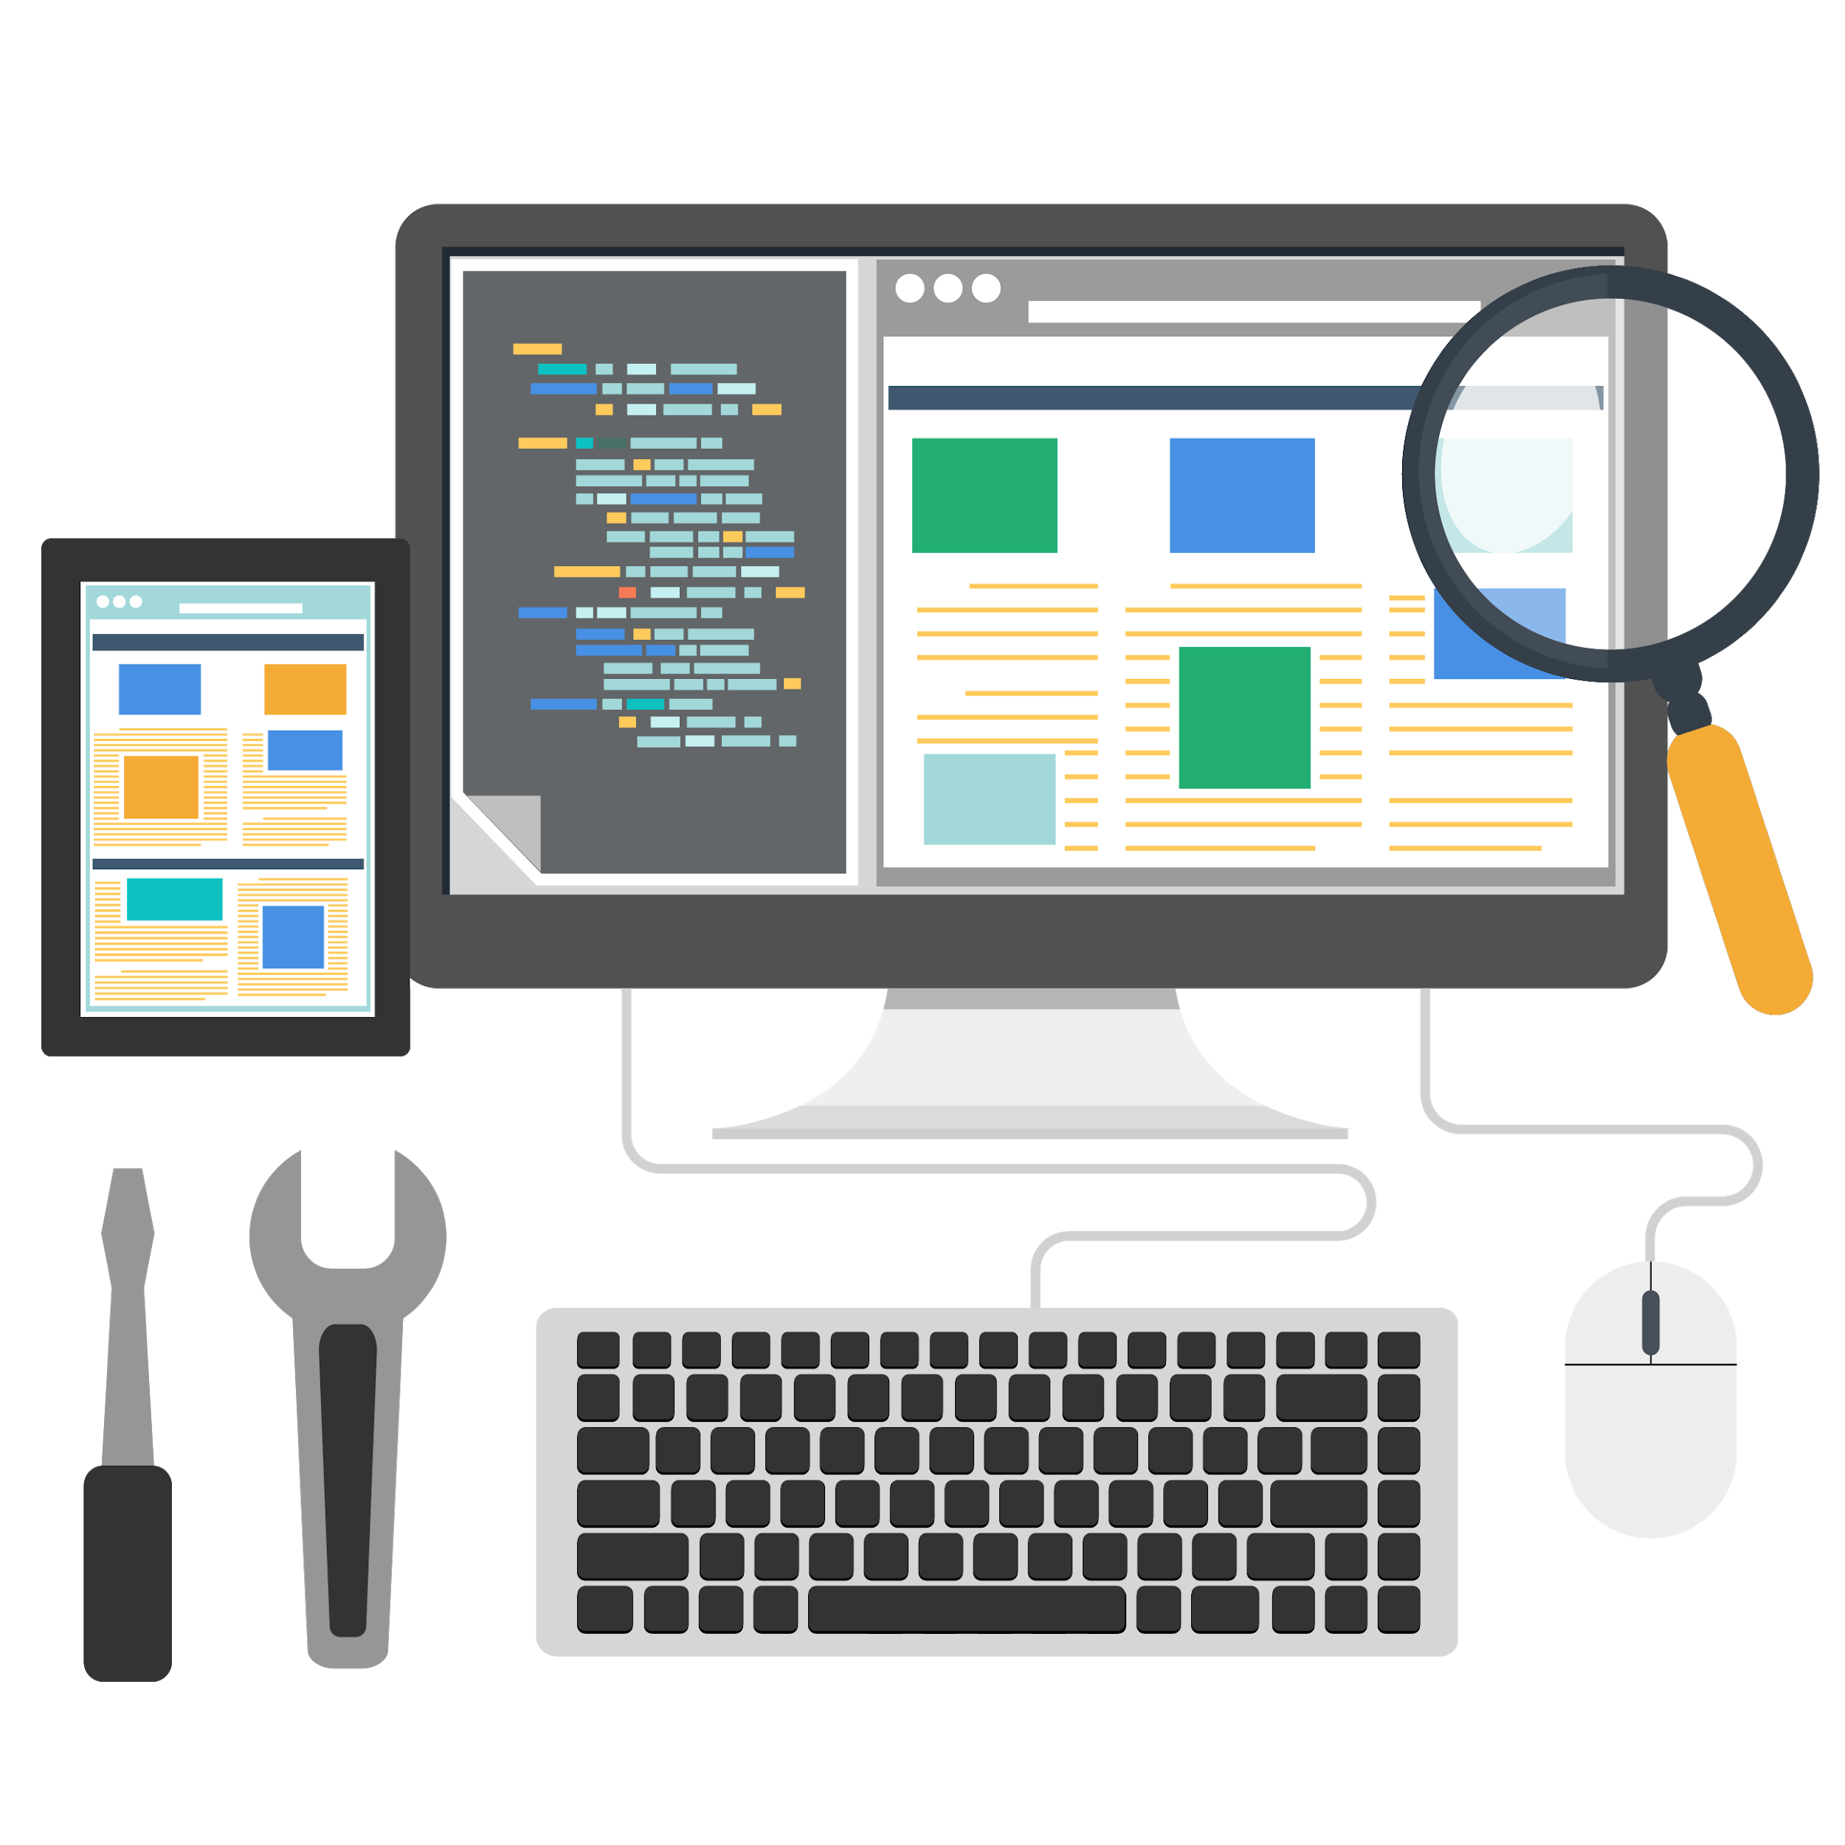
What is Software Testing?
Software Testing refers to the process of evaluating software against requirements collected from users and system specifications. Testing is conducted at various phase levels in a Software Development Life Cycle (SDLC). Software testing includes validation and verification.

Slide 9
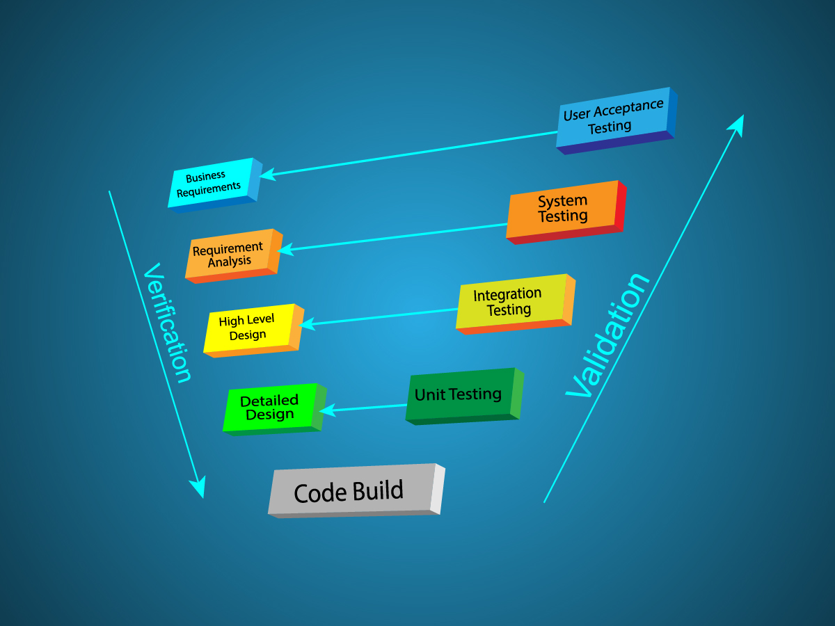
Software Validation and Verification

Slide 10
What is Software Testing?
Software Validation:
Validation ensures that the product under development is in accordance with the original user requirements.
Validation means asking - “Are we developing a product that meets users’ expectations?”
Validation lays emphasis on users’ requirements.

Slide 11
What is Software Testing?
Software Verification:
Verification ensures that the product is being developed in accordance with design specifications.
Verification means asking - “Are we developing the product by strictly following all design specifications?”
Verification focuses on design and system specifications.

Slide 12
Poll 2(15 Sec)
What is the difference between software validation and software verification?
Validation: Are we building the product right?
Verification: Are we building the right product?
Verification: Are we building the product right?
Validation: Are we building the right product?
Practice in teams of 4 students
Industry expert mentoring to learn better
Get personalised feedback for improvements

Slide 13
Poll 2(Answer)
What is the difference between software validation and software verification?
Validation: Are we building the product right?
Verification: Are we building the right product?
Verification: Are we building the product right?
Validation: Are we building the right product?
Practice in teams of 4 students
Industry expert mentoring to learn better
Get personalised feedback for improvements

Slide 14

Why Software Testing?

Slide 15
Why Software Testing?
Detecting errors and faults
Statistics for shareholders and for reflecting the current status of the organisation
Improving product standards
Eliminating risks
Evaluating credibility
Demonstrating accessibility and feasibility

Slide 16
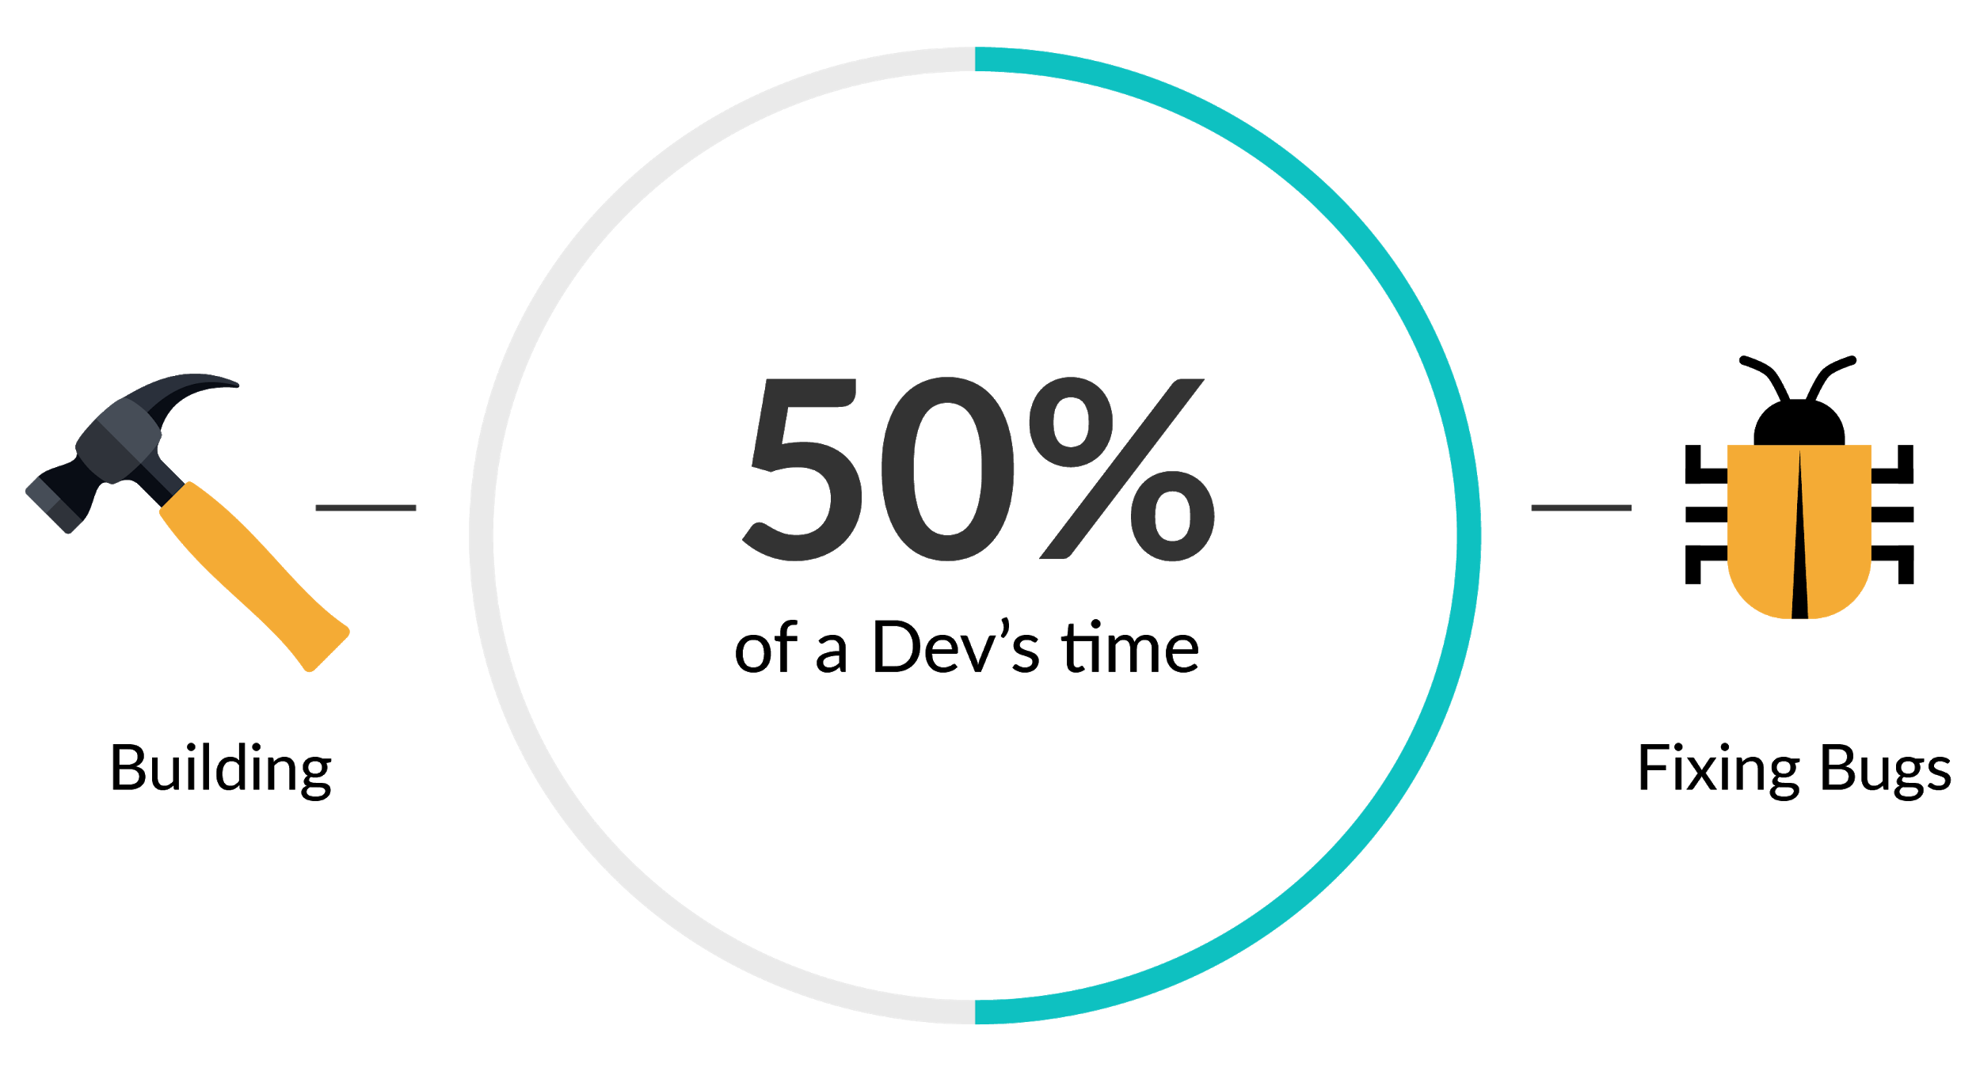
Some Famous Bugs in History

Slide 17
Some Bugs in History…
Any software failure can have devastating results on company's value and reputation. UK-based loan company lost 1.7 billion pounds worth of market value last year after their scheduling application failed.
You would have not heard of an incident where an divorce took place due to a bug in the software. But, it did happen due to a bug in the Uber app. Due to the bug, the man’s affair got exposed to his wife leading to a divorce.

Slide 18
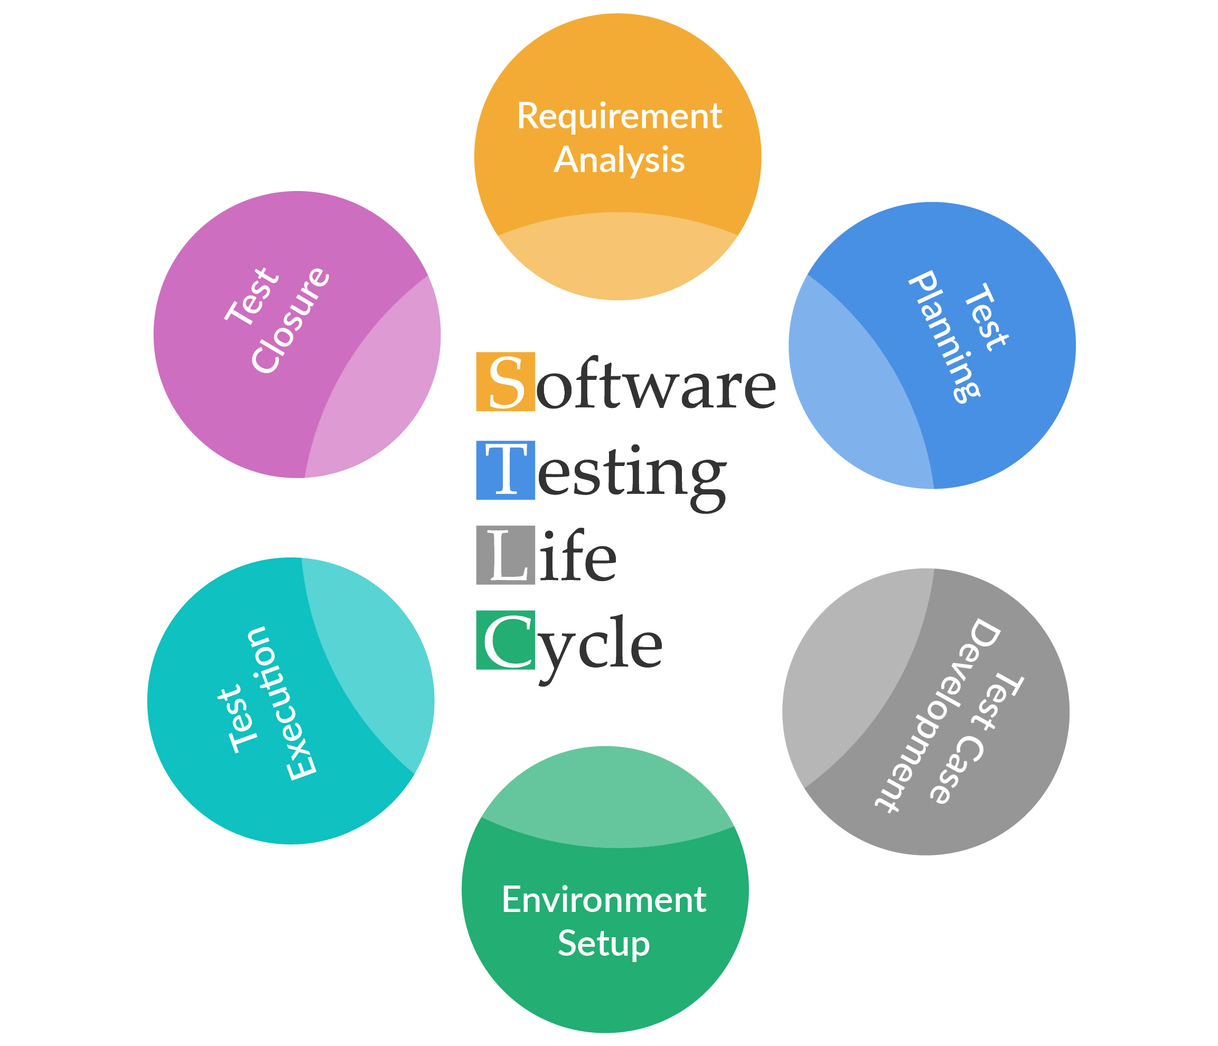
Software Testing Life Cycle

Slide 19
STLC
Software Testing Life Cycle (STLC) is an end-to-end process for testing software and ensuring that its quality meets the defined standards.
In this process, tests are carried out systematically over several phases.
STLC has the following different phases:
Requirement analysis
Test planning
Test case development
Test environment set-up
Test execution
Test cycle closure

Slide 20
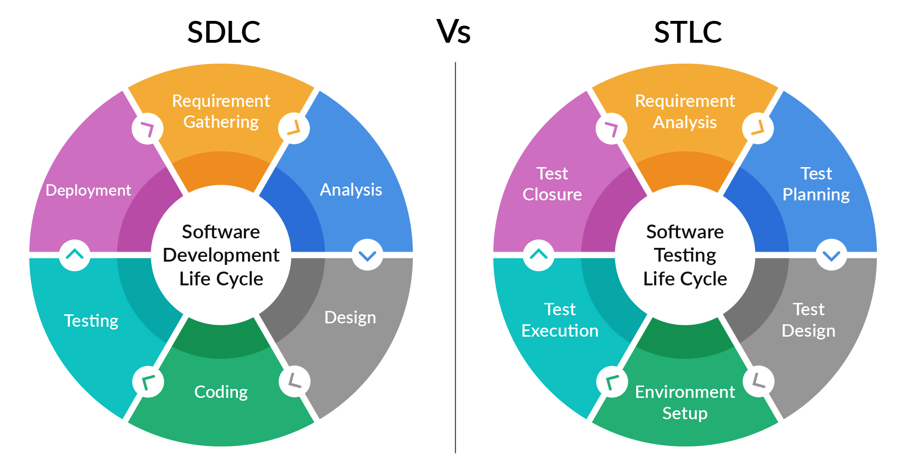
SDLC vs STLC

Slide 21
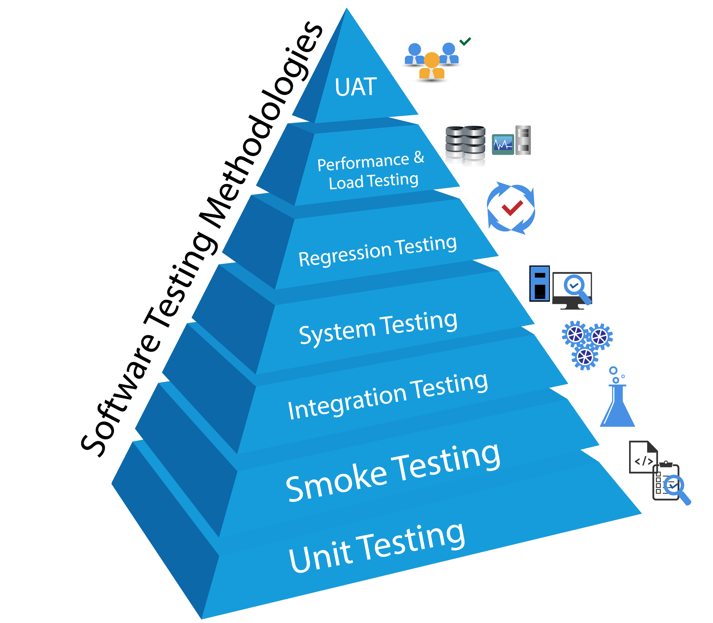
Software Testing Methodologies

Slide 22
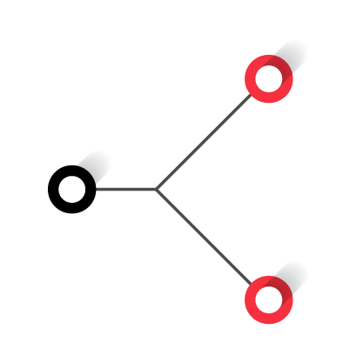
Software Testing Methodologies
Functional
Testing
Software
Testing
Non-Functional
Testing

Slide 23
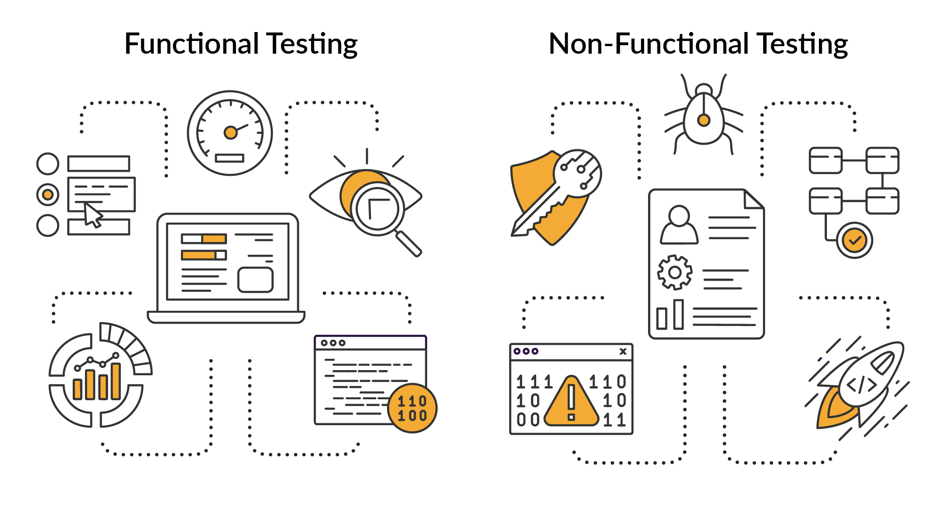
Functional Testing

Slide 24
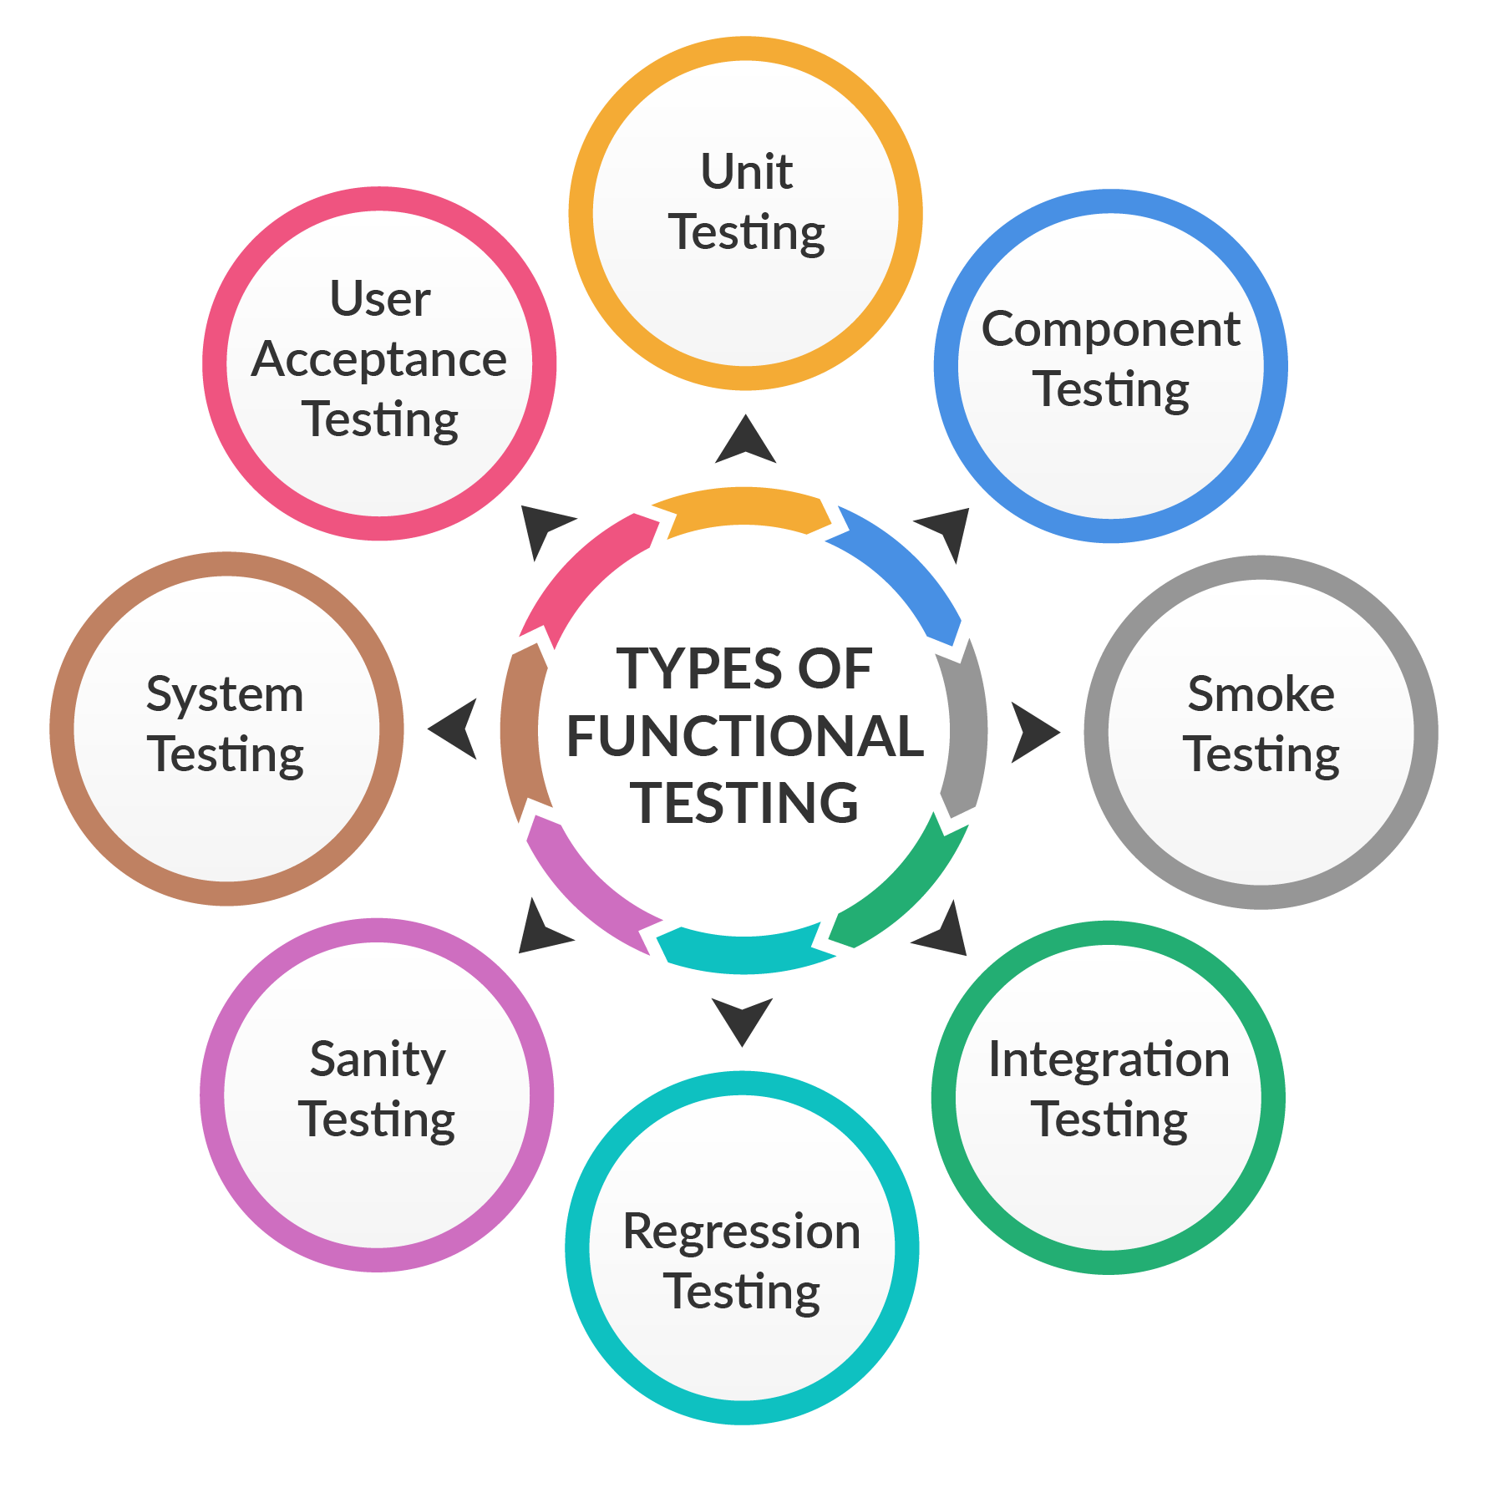
Software Testing Methodologies
Functional Testing

Slide 25

Unit Testing

Slide 26
Functional Testing
Unit Testing
Unit testing verifies that each part of the code developed in a component produces the required output.
In unit testing, developers focus only on the interface and the specifications defined for a particular component.
Unit testing provides a documentation for developing code, as each unit of code is tested extensively as standalone before progressing to/integrating with another unit of application.
Unit tests support functional tests by exercising the code that is most likely to break. If you use functional tests without a unit test, then you may experience several issues such as the ones listed below:
It is difficult to diagnose failed tests.
Test fixtures work well when the issues are known and not for diagnosing the issues.

Slide 27
Functional Testing
Unit Testing
code is checked-out from the repository
code is checked-in into the repository
Changes are made on the code
Review the code
Defects are fixed and unit test is performed again
Unit test cases are executed

Slide 28
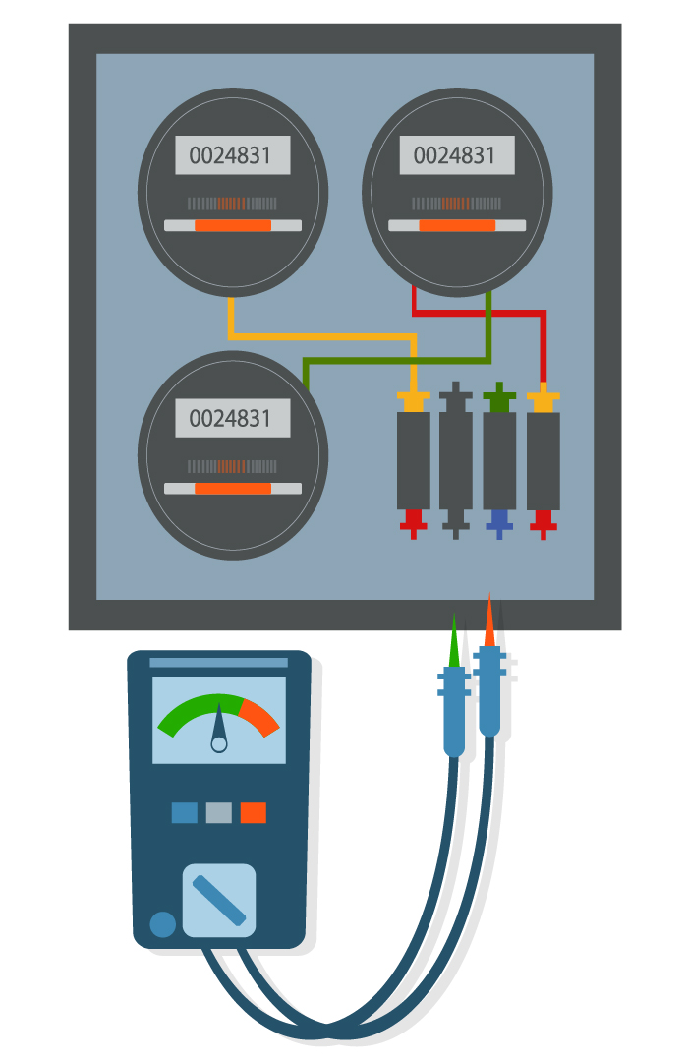
Component Testing

Slide 29
Functional Testing
Component Testing
Component testing refers to the method of testing a component independently to validate its expected output against an input.
It is performed to validate the functionality and usability of a component, although it is not restricted to only these aspects.
A component is something that takes an input and gives some output. Web pages, modules of a bigger code are some examples of components.

Slide 30
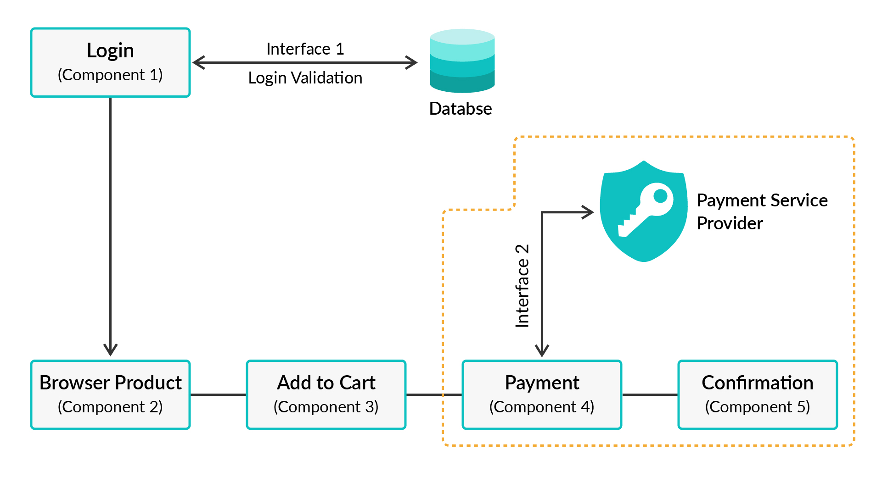
Functional Testing
Component Testing

Slide 31
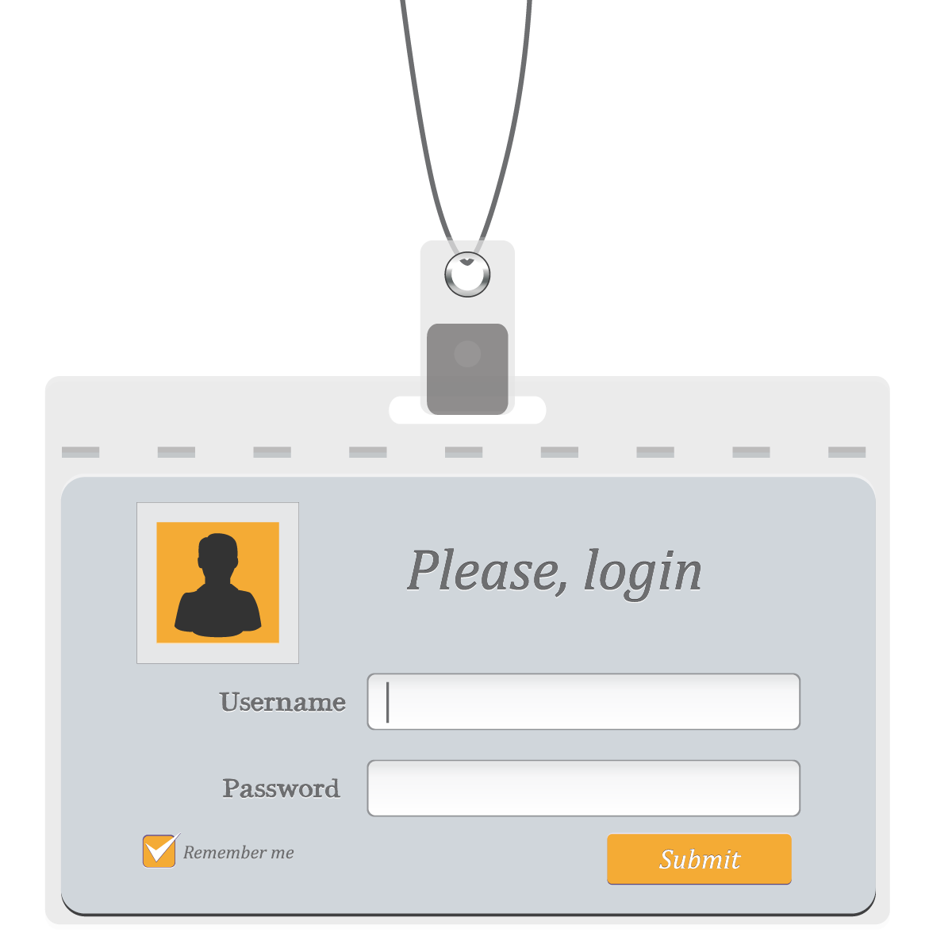
Hands-On Exercise 1 (2 mins)
What are the different features that we can test in the login component?
We can test the UI part for usability and accessibility.
We can test page loading to ensure performance.
We can try SQL injection through the UI components to ensure security of the application.
We can test the login functionality using valid and invalid credentials.

Slide 32
Poll 3(15 Sec)
What is the difference between unit testing and component testing?
(Note: More than one option can be correct)
Unit testing is performed before component testing.
Component testing validates design documents and unit testing validates test requirements.
Unit testing validates design documents and component testing validates test requirements.
Component testing is performed before unit testing.
Practice in teams of 4 students
Industry expert mentoring to learn better
Get personalised feedback for improvements
You can read more here.

Slide 33
Poll 3(Answer)
What is the difference between unit testing and component testing?
(Note: More than one option can be correct)
Unit testing is performed before component testing.
Component testing validates design documents and unit testing validates test requirements.
Unit testing validates design documents and component testing validates test requirements.
Component testing is performed before unit testing.
Practice in teams of 4 students
Industry expert mentoring to learn better
Get personalised feedback for improvements
You can read more here.

Slide 34

Integration Testing

Slide 35
Functional Testing
Integration Testing
Integration testing is conducted to test individual components to assess how they function when put together.
It is performed to test modules that function as expected individually and, therefore, do not show bugs/issues when integrated.
It usually reveals issues with UI operations, data formats, operation timings, API calls and database access, and any form of user interface operations.

Slide 36
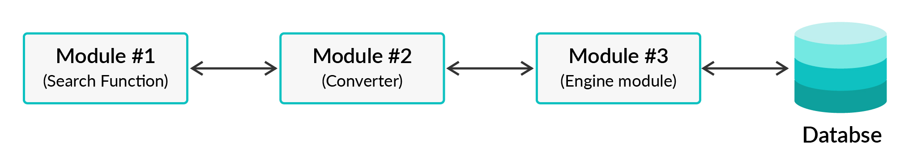
Functional Testing
Integration Testing
Database

Slide 37

System Testing

Slide 38
Functional Testing
System Testing
System testing refers to the testing that is performed on a complete, integrated system, as a means to evaluate its compliance with specified requirements.
It is conducted by independent testers who have not participated in application development.
It is performed in an environment that closely resembles a production environment.
It can be performed when all the modules have been developed and have successfully passed integration.

Slide 39
Sanity Testing

Slide 40
Functional Testing
Sanity Testing
When we receive a new build with minor modifications, we conduct a sanity test, instead of performing thorough regression testing.
A sanity test checks whether the modifications have actually resolved the issue(s) and that the fixes have not introduced any new issues in the product.
It is generally a subset of regression testing.

Slide 41
Smoke Testing

Slide 42
Functional Testing
Smoke Testing
Smoke testing is conducted on a new build that is provided to the QA team by the team of developers to validate whether or not the basic functionalities are working fine.
In smoke testing, the test cases that are selected cover the most important functionality or component part/module of the system.
The objective here is not to conduct thorough testing, but to validate that the critical functionalities of the system are working as per the expected behaviour.

Slide 43
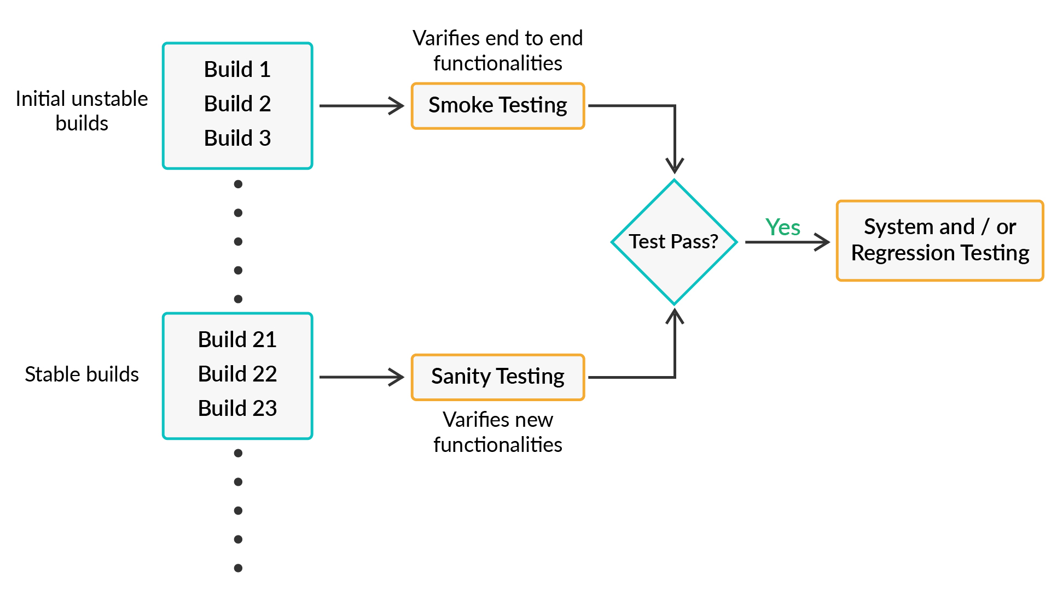
Functional Testing
Sanity/Smoke Testing
Verifies
Verifies

Slide 44
Poll 4(15 Sec)
What is the difference between sanity testing and smoke testing?
Smoke testing is performed to ensure that the critical functionalities of the product are working fine, while sanity testing verifies whether bugs have been fixed in the new build.
Sanity testing is performed to ensure that the critical functionalities of the product are working fine, while smoke verifies whether bugs have been fixed in the new build.
Practice in teams of 4 students
Industry expert mentoring to learn better
Get personalised feedback for improvements
You can read more about these here.

Slide 45
Poll 4(15 Sec)
What is the difference between sanity testing and smoke testing?
Smoke testing is performed to ensure that the critical functionalities of the product are working fine, while sanity testing verifies whether bugs have been fixed in the new build.
Sanity testing is performed to ensure that the critical functionalities of the product are working fine, while smoke verifies whether bugs have been fixed in the new build.
Practice in teams of 4 students
Industry expert mentoring to learn better
Get personalised feedback for improvements
You can read more about these here.

Slide 46
Regression Testing

Slide 47
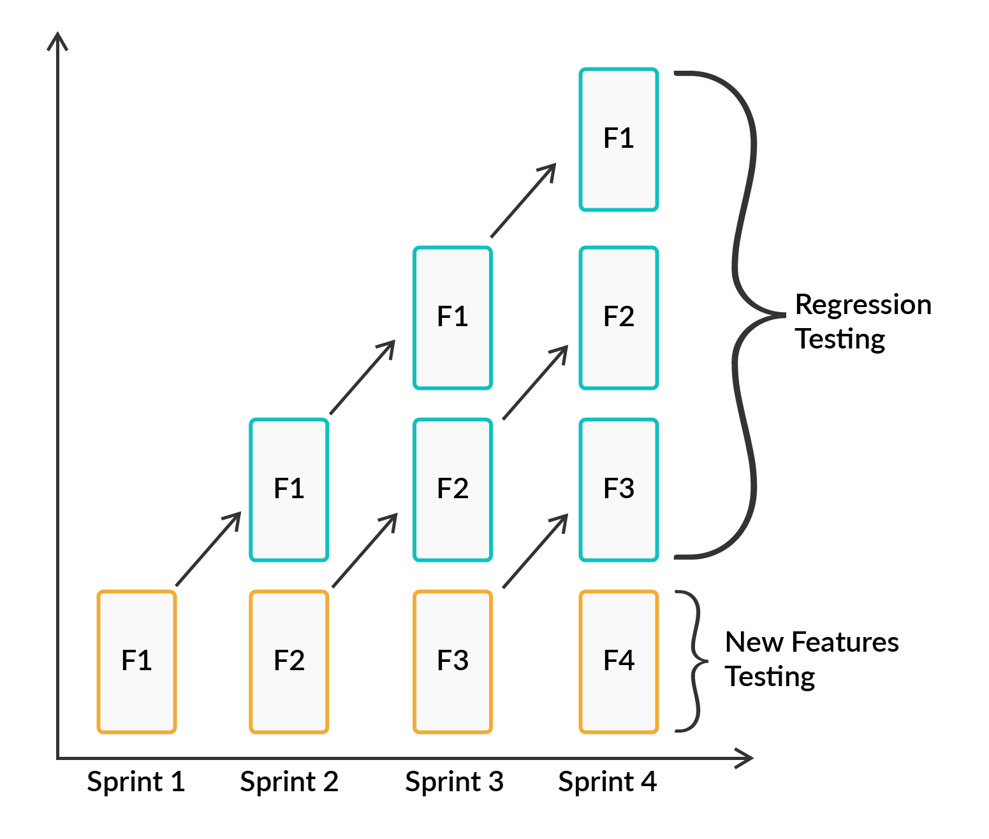
Functional Testing
Regression Testing
Regression testing is performed to ensure that a change made or an addition has not affected any of the existing functionalities of an application.
The purpose of this testing is to detect bugs that may accidentally have been introduced into the existing build, while ensuring that bugs that were removed previously continue to remain fixed.

Slide 48
Poll 5(15 Sec)
Which of the following is not a characteristic of regression testing?
Regression testing can be performed on each level.
It is done to demonstrate that software is not changed intentionally.
It is done to demonstrate that new defects are not introduced after adding a new functionality or after correcting a previous defect.
It is the best candidate for automation.
Practice in teams of 4 students
Industry expert mentoring to learn better
Get personalised feedback for improvements

Slide 49
Poll 5(Answer)
Which of the following is not a characteristic of regression testing?
Regression testing can be performed on each level.
It is done to demonstrate that software has not changed intentionally.
It is done to demonstrate that new defects are not introduced after adding a new functionality or after correcting a previous defect.
It is the best candidate for automation.
Practice in teams of 4 students
Industry expert mentoring to learn better
Get personalised feedback for improvements

Slide 50
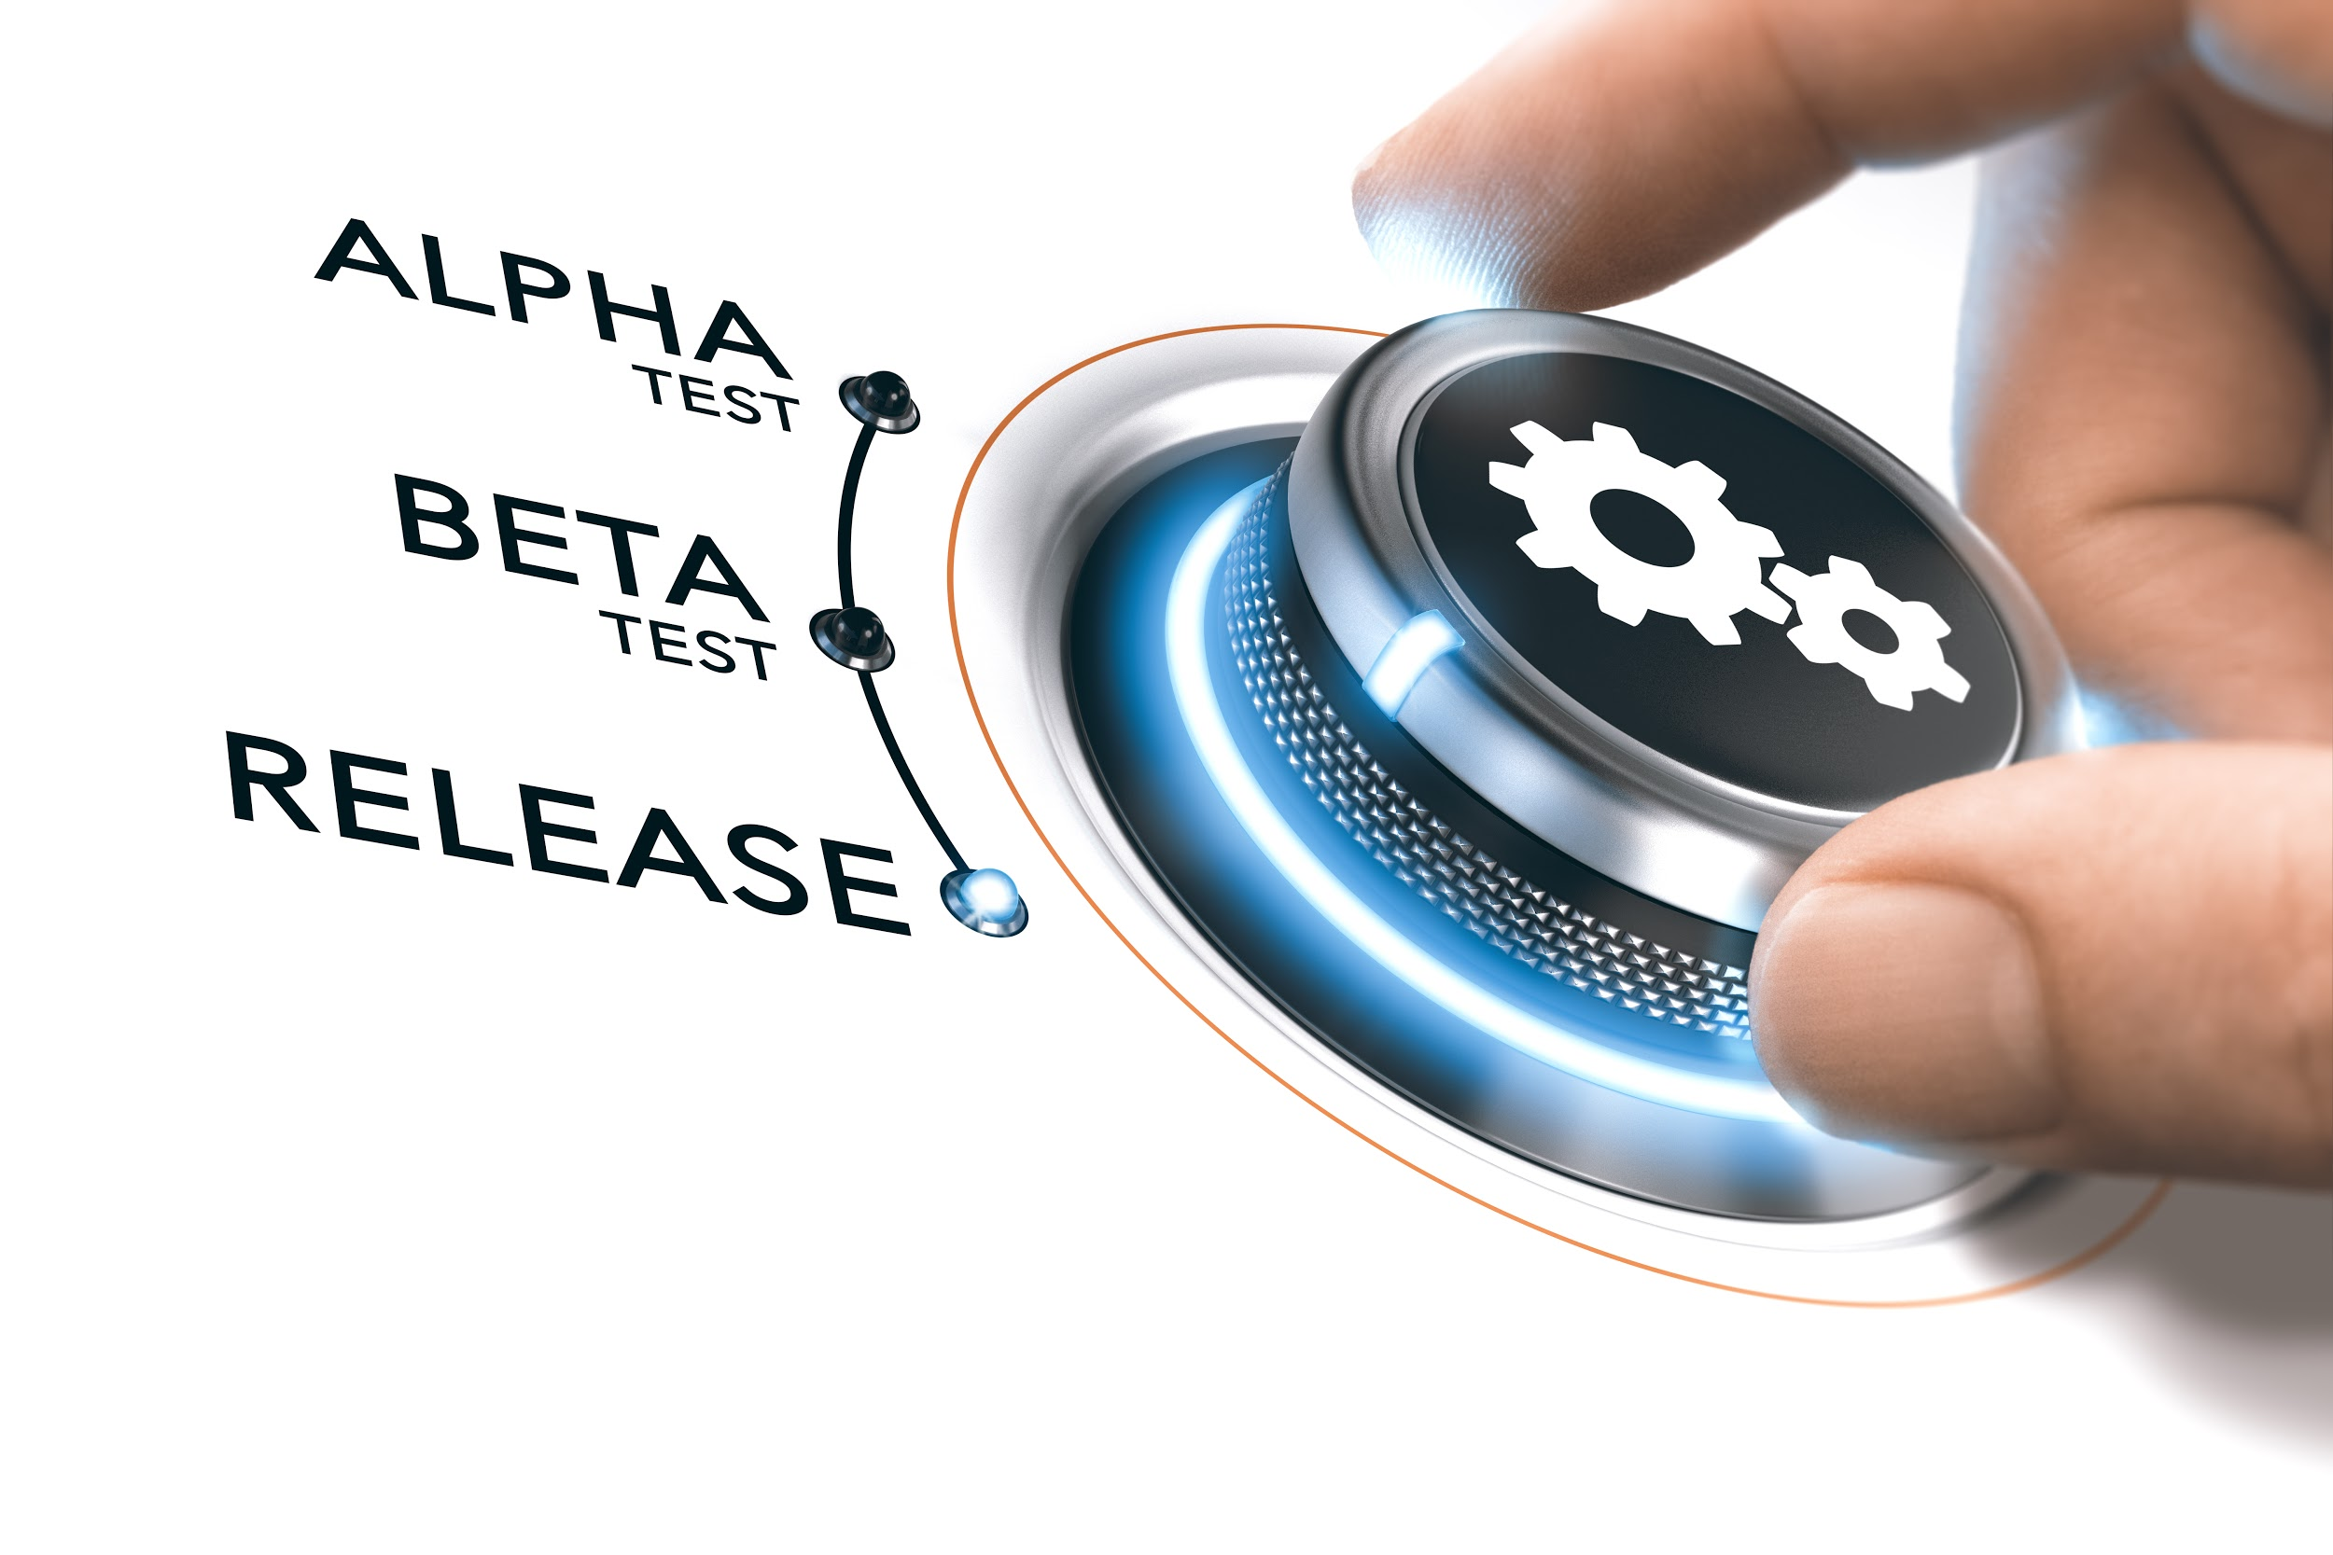
User Acceptance Testing

Slide 51
Functional Testing
User Acceptance Testing
User acceptance testing is the final and, at the same time, a crucial phase of software testing.
In UAT, actual software users test the products to ensure they can perform the required tasks in real-life scenarios.
It is typically conducted during product delivery to stakeholders, as a final checkpoint among all forms of functional testing.
The users are naive about the working of the application. They focus more on ‘How should the application behave?’ They use the application with a clear mind to check whether it is easy to use it or not. UAT is based on user stories and it helps in demonstrating how well the application meets the users’ requirements.
In UAT, users do not adopt the typical ‘Test to Break’ approach while testing software. Instead, it is a measure of how well your application performs in normal situations.

Slide 52
Poll 6 (15 Sec)
Which of the following testings is concerned with the behaviour of a whole product as per specified requirements?
Acceptance testing
Component testing
System testing
Integration testing
Practice in teams of 4 students
Industry expert mentoring to learn better
Get personalised feedback for improvements

Slide 53
Poll 6(Answer)
Which of the following testings is concerned with the behaviour of a whole product as per specified requirements?
Acceptance testing
Component testing
System testing
Integration testing
Practice in teams of 4 students
Industry expert mentoring to learn better
Get personalised feedback for improvements

Slide 54
Doubt Clearing (5 mins)

Slide 55
Non-Functional Testing

Slide 56
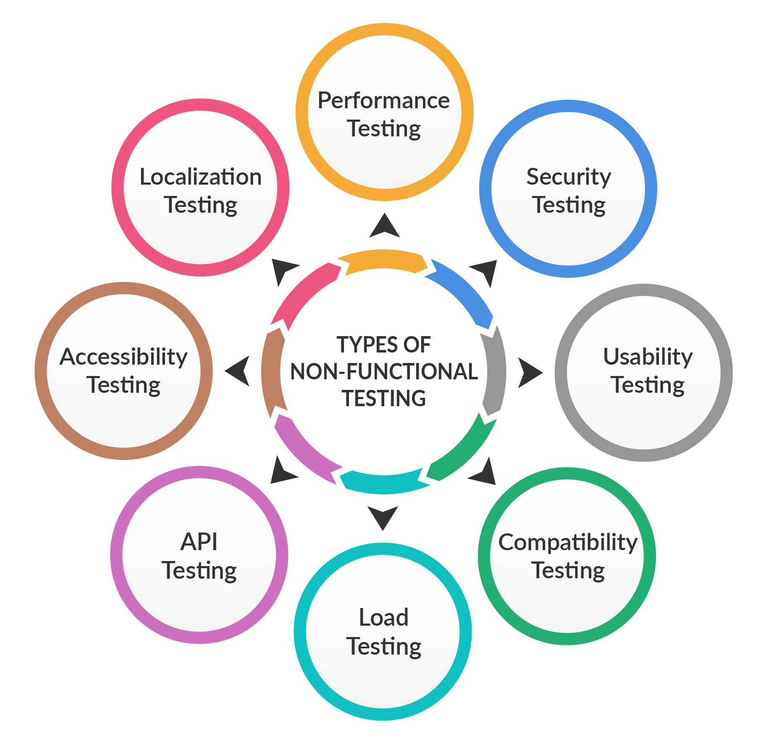
Non-Functional Testing

Slide 57
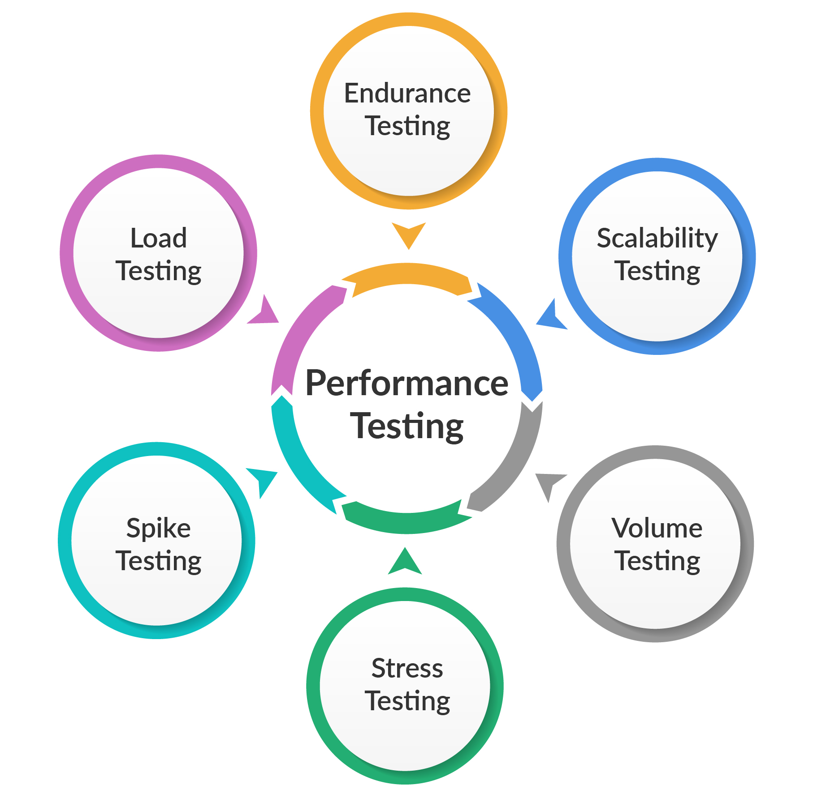
Performance Testing

Slide 58
Non-Functional Testing
Performance Testing
Performance testing is used to evaluate how a system performs with regard to responsiveness and stability under a particular traffic.
Performance tests are typically conducted to evaluate the speed, robustness, reliability and size of an application. The process includes ‘performance’ indicators such as:
Browser, page and network response times (rps/rpm)
Server request processing times (rpm/rps)
Acceptable concurrent user volumes
Processor memory consumption, CPU utilisation, memory utilisation, etc

Slide 59
Poll 7(15 Sec)
Some more specific reasons for conducting performance testing include:
Assessing release readiness
Assessing infrastructure adequacy
Assessing adequacy of developed software’s performance
Improving the efficiency of performance tuning
All of the above
Practice in teams of 4 students
Industry expert mentoring to learn better
Get personalised feedback for improvements

Slide 60
Poll 7(Answer)
Some more specific reasons for conducting performance testing include:
Assessing release readiness
Assessing infrastructure adequacy
Assessing adequacy of developed software’s performance
Improving the efficiency of performance tuning
All of the above
Practice in teams of 4 students
Industry expert mentoring to learn better
Get personalised feedback for improvements

Slide 61
Security Testing (Optional)

Slide 62

Non-Functional Testing
Security Testing
Security testing is performed with the aim to unveil flaws in security mechanisms, and detect vulnerabilities or weaknesses of the software application that is being tested.
The goal of security testing is to identify pitfalls of the system and evaluate its potential vulnerabilities in advance, so it does not stop functioning or is exploited by hackers.
It also helps in detecting possible security risks in the system and also enables developers to fix them through coding (Ethical Hacking).

Slide 63
Compatibility
Testing
(Optional)

Slide 64
Non-Functional Testing
Compatibility Testing
Compatibility testing is essential in the current market due to the great diversity of existing platforms and hardware. One must have knowledge of this diversity and also ensure that their app/software is functioning seamlessly across different operating systems, browsers and devices.
Compatibility testing is conducted to ensure that the final product performs as expected on devices of various specifications.
Compatibility
Testing
Backward
Forward

Slide 65
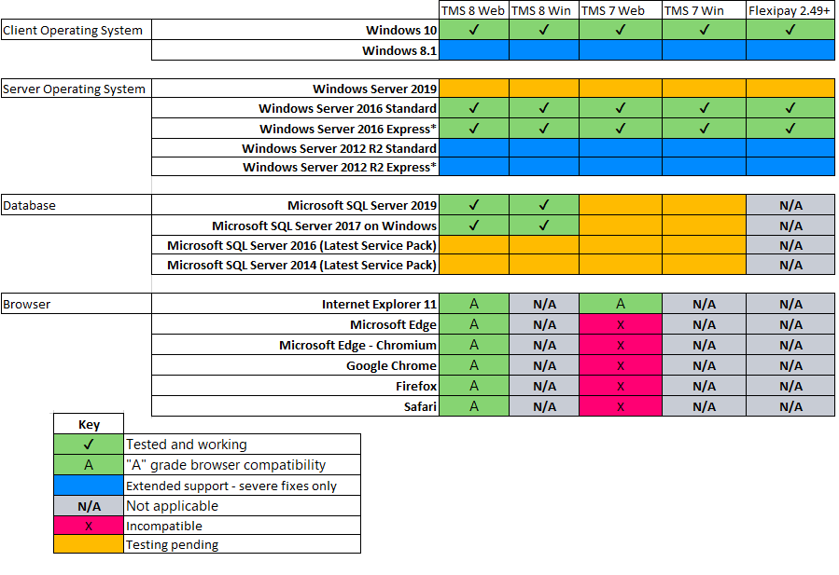
Non-Functional Testing
Compatibility Testing

Slide 66
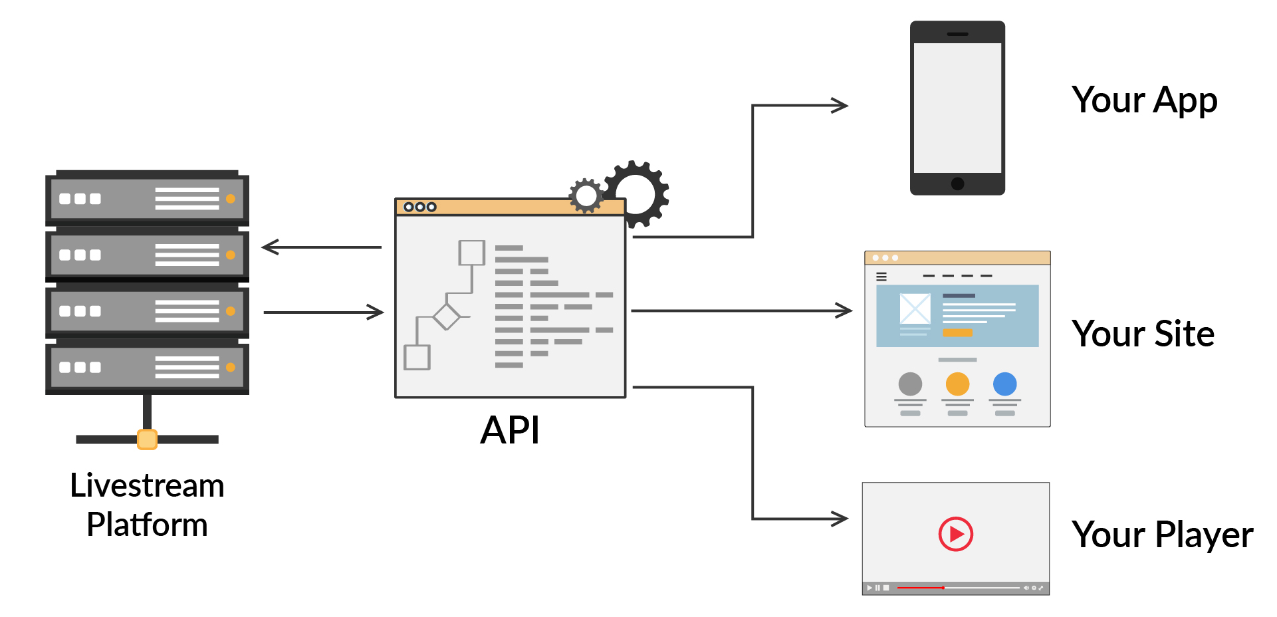
API Testing

Slide 67
API Testing
API testing is used to examine Application Programming Interfaces (APIs).
It checks the functionality, reliability, performance and security of the programming interfaces involved in an application ecosystem.
APIs are the connecting nerves between different systems or layers of an application.
Applications often have three layers: data layer, service (API) layer and presentation (UI) layer.
Here, the API layer holds the application’s business logic - the rules that define how users can interact with the services, data or functions of the application. Since the API, or the service layer, interacts directly with both the data layer as well as the presentation layer, it provides the sweet spot for continuous testing by the QA team.

Slide 68

Load
Testing

Slide 69
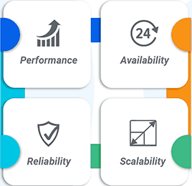
Non-Functional Testing
Load Testing
Load testing allows evaluating the response times, throughput rates and resource utilisation levels, and also to identify the breaking point of your application.
It ensures that your application is able to perform as expected in production.
It identifies conditions in which the application breaks under heavy traffic.

Slide 70
Localisation
Testing
(Optional)

Slide 71
Non-Functional Testing
Localisation Testing
Localisation testing is the process of customising a software application in accordance with a target language and country.
It is a process for testing a globalised application, and it ensures that the application’s default language, UI, currency, date, time format and documentation are designed in accordance with the target audience/country.
It ensures that the application is sufficiently capable of use in the target country/region/locale.
Characteristics of localisation testing:
Affected modules include such component as UI and content
Critical business scenario testing
Upgradation and installation tests that are run in the localised environment
Checking for error messages, resource attributes and linguistic errors as per targeted locale
Any typographical errors

Slide 72
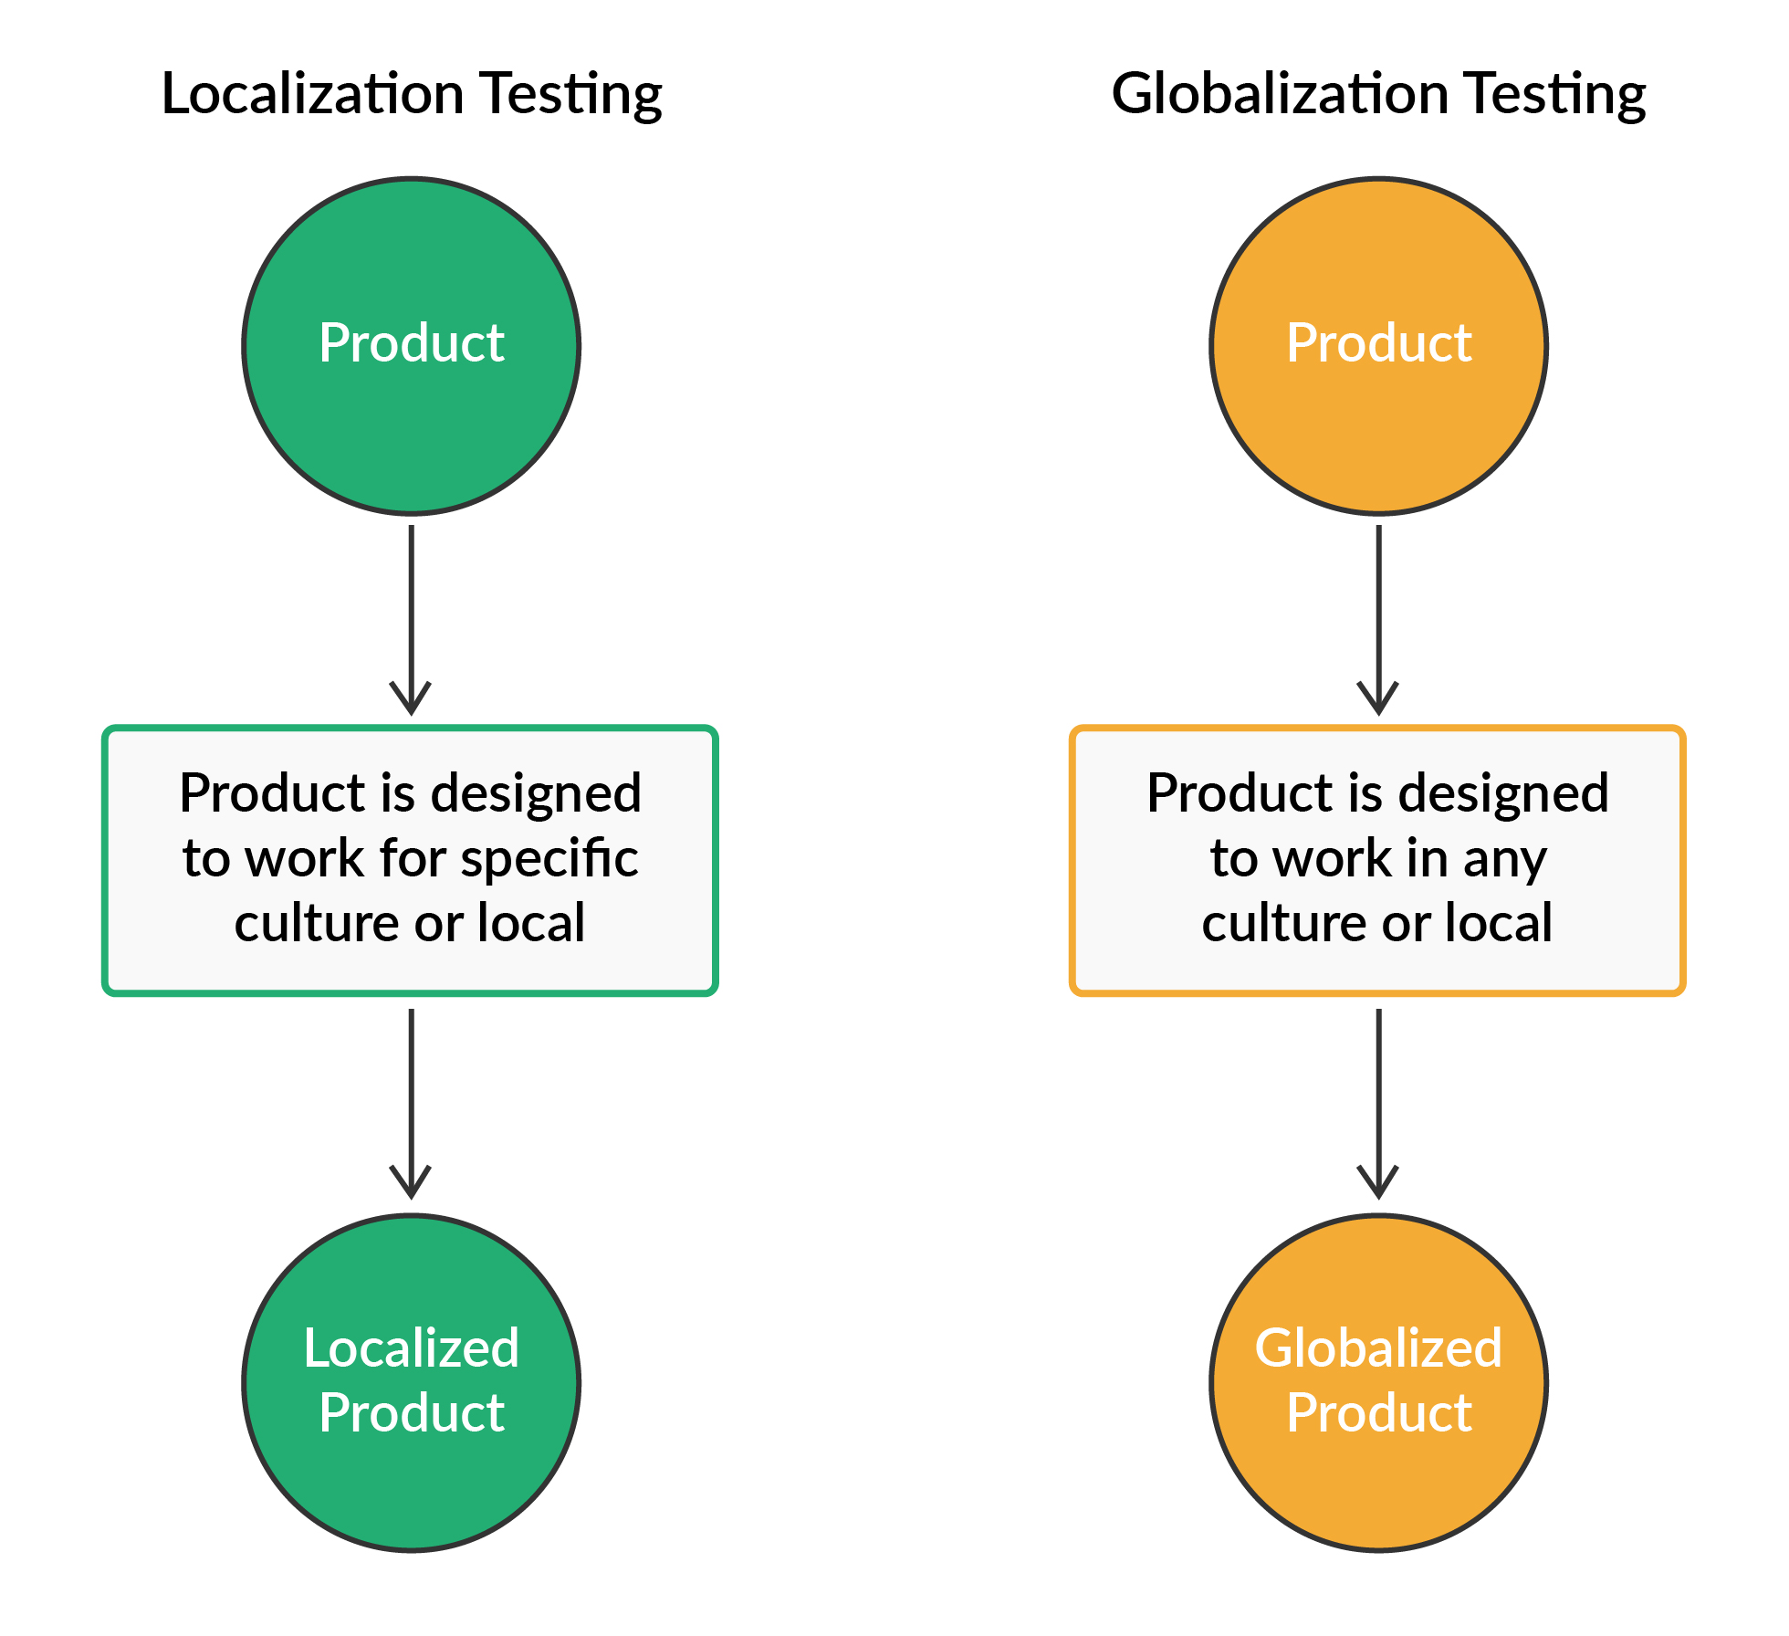
Non-Functional Testing
Localisation Testing

Slide 73

Project Work (15 mins)
Online Food Ordering Website
Let’s discuss different testing terms discussed so far with respect to the architecture of an online food ordering system like Zomato.
Try to relate it with all that you have learnt so far and discuss what all can be tested in the paradigm of a website like Zomato.
Chalk out different types of functional and non-functional testings, and define them briefly.
You can refer to the solution here.

Slide 74
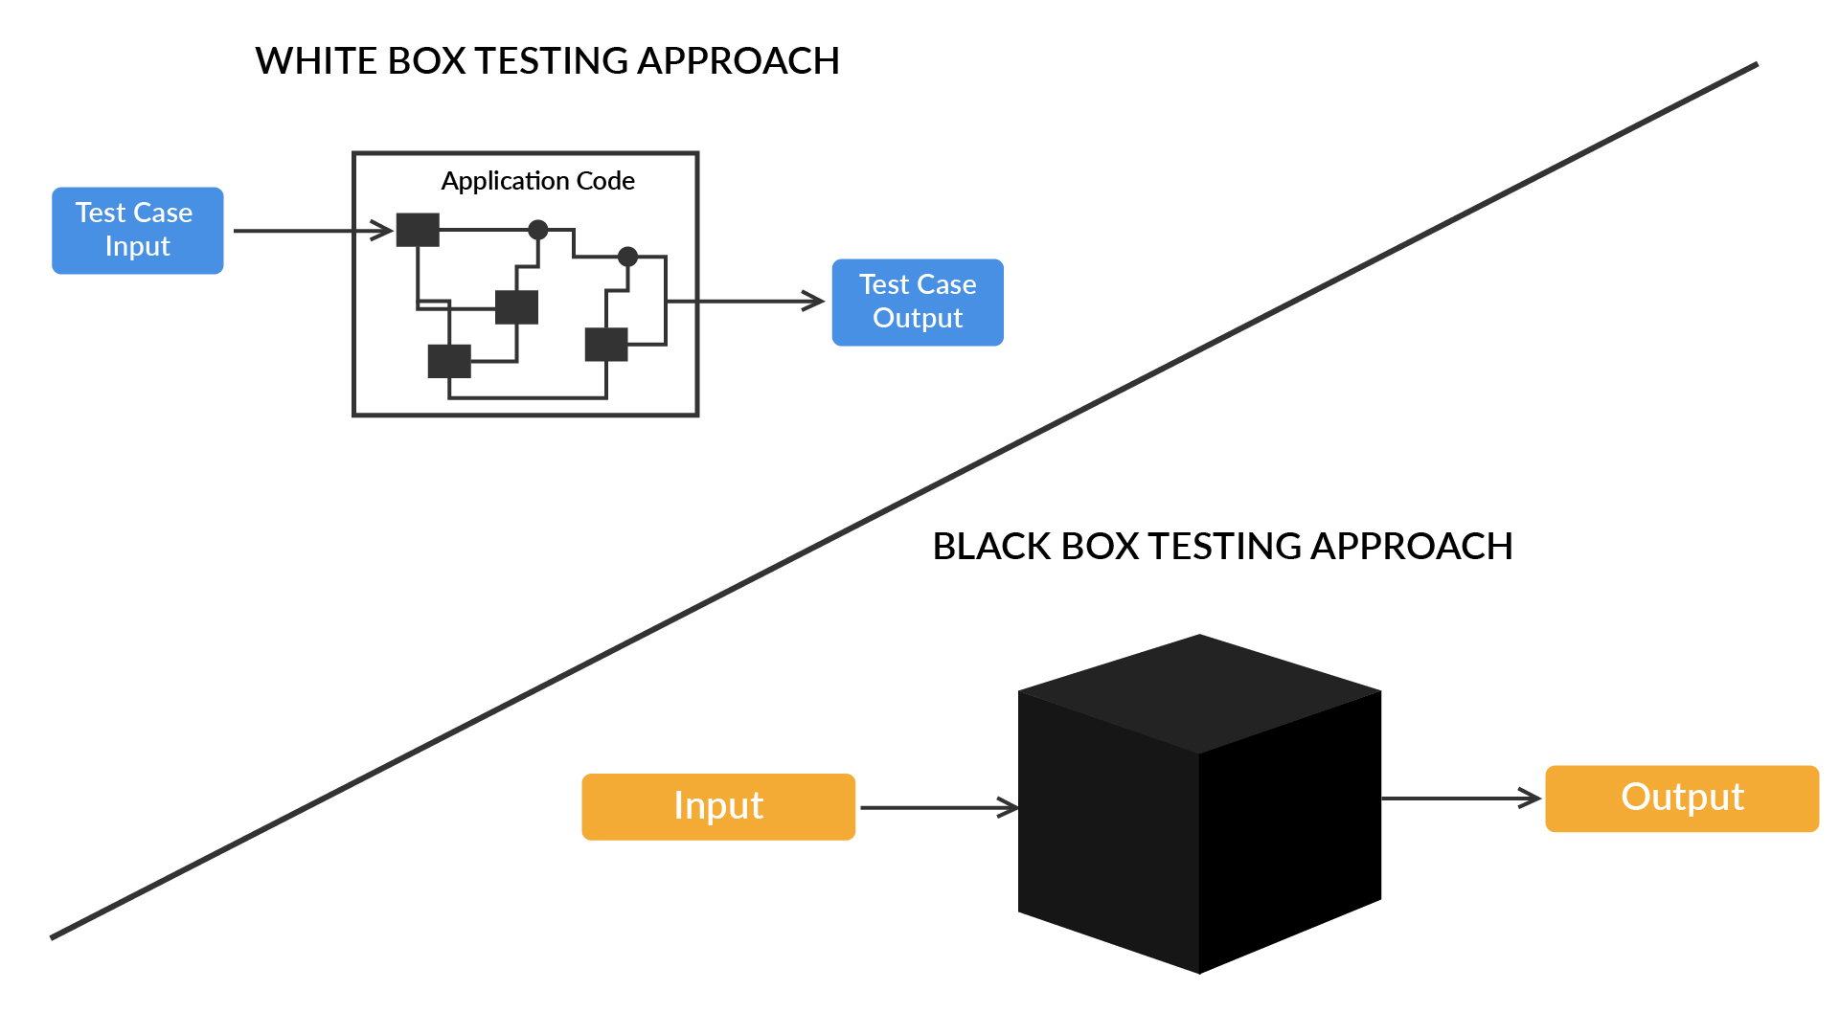
White-Box Testing

Slide 75
Black-Box and White-Box Testing
White-Box Testing
White-box testing is a technique that is used to examine the correctness of the internal functioning of the software system.
It is based on coverage of code statements, branches, paths, dataflows or conditions.
It is considered low-level testing. It is also referred to as glass-box/code-based testing.

Slide 76
White-Box Testing
Code Coverage
Code coverage is a software testing metric that is used to determine the number of lines of code that are validated successfully in a test. This metric, in turn, helps analyse how comprehensively a software is verified.
In addition to handing over software to QA engineers for bug-tracking, it is extremely important to analyse, monitor and evaluate test activities, and this means you should consider testing metrics to evaluate the effectiveness and completeness of the test suit.
Code coverage is one such software testing metric, which can help you analyse any software’s test performance and quality aspects:
Code Coverage % = (Number of lines of code executed by a testing algorithm/Total number of lines of code in a system component) * 100

Slide 77
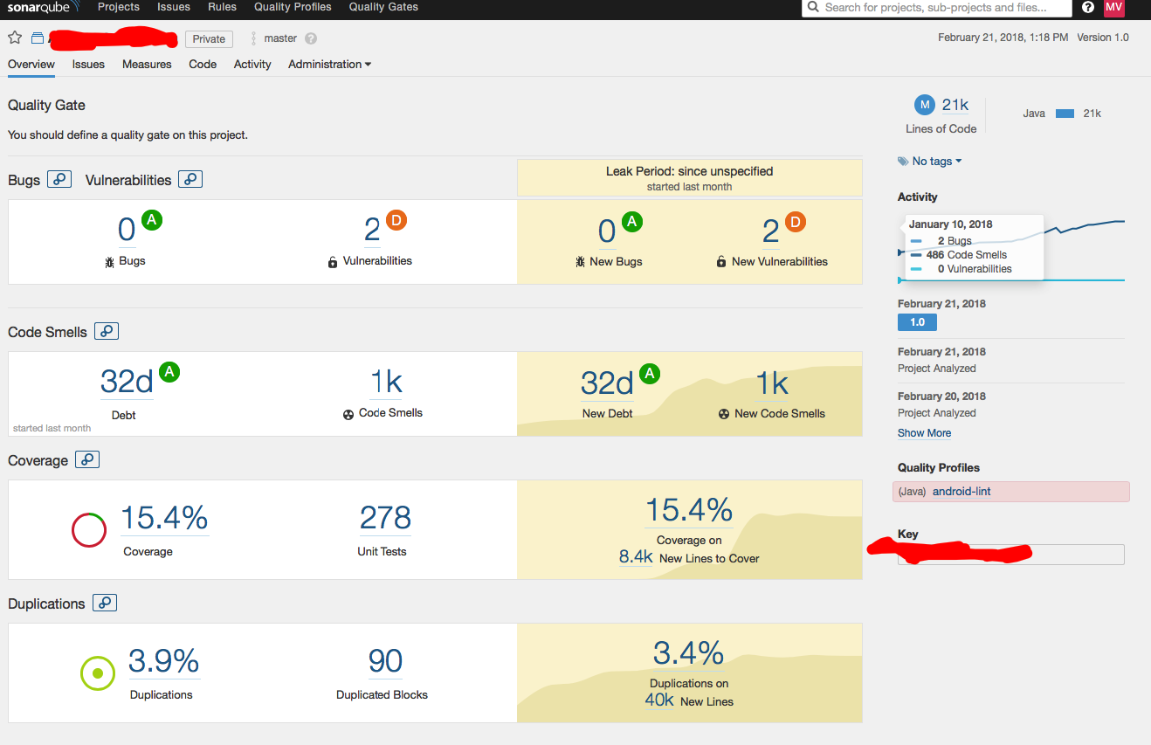
White-Box Testing
Code Coverage
You can refer to the solution here.

Slide 78
White-Box Testing
A few other terms of white-box testing are as follows:
Function Coverage - The functions that are present in the source code are executed at least once.
Statement Coverage - This refers to the number of statements in the source code that have been validated successfully.
Path Coverage - This refers to the flows, which have a sequence of controls and conditions that have worked well at least once.
Branch or Decision Coverage - This refers to decision control structures (for example, loops) that have executed correctly.
Condition Coverage - This refers to Boolean expressions that are validated and which return both TRUE/FALSE according to the test run.

Slide 79
White-Box Testing
Advantages & Disadvantages
Advantages:
The tester has knowledge of the source code, hence it becomes very easy to find out which type of data can help in testing the application more effectively.
It helps in optimizing the overall code.
Extra lines of code can be removed very easily which can then bring in hidden defects.
Due to the tester's knowledge about the code, the maximum coverage is attained while writing out test scenarios.
Disadvantages:
Since a skilled tester is needed to perform white-box testing, the costs spike.
Sometimes it’s impossible to investigate every nook & corner to find all sorts of hidden errors, as many paths will go untested.
It’s difficult to maintain white-box testing, as it requires specialized tools like code analyzers & debugging tools.

Slide 80
Poll 8 (15 Sec)
Code coverage analysis is the process of:
Finding areas of a program that are not exercised by a set of test cases
Creating additional test cases to increase coverage
Determining a quantitative measure of code coverage, which is an indirect measure of quality
All of the above
Practice in teams of 4 students
Industry expert mentoring to learn better
Get personalised feedback for improvements

Slide 81
Poll 8 (Answer)
Code coverage analysis is the process of:
Finding areas of a program that are not exercised by a set of test cases
Creating additional test cases to increase coverage
Determining a quantitative measure of code coverage, which is an indirect measure of quality
All of the above
Practice in teams of 4 students
Industry expert mentoring to learn better
Get personalised feedback for improvements

Slide 82
Black-Box Testing

Slide 83
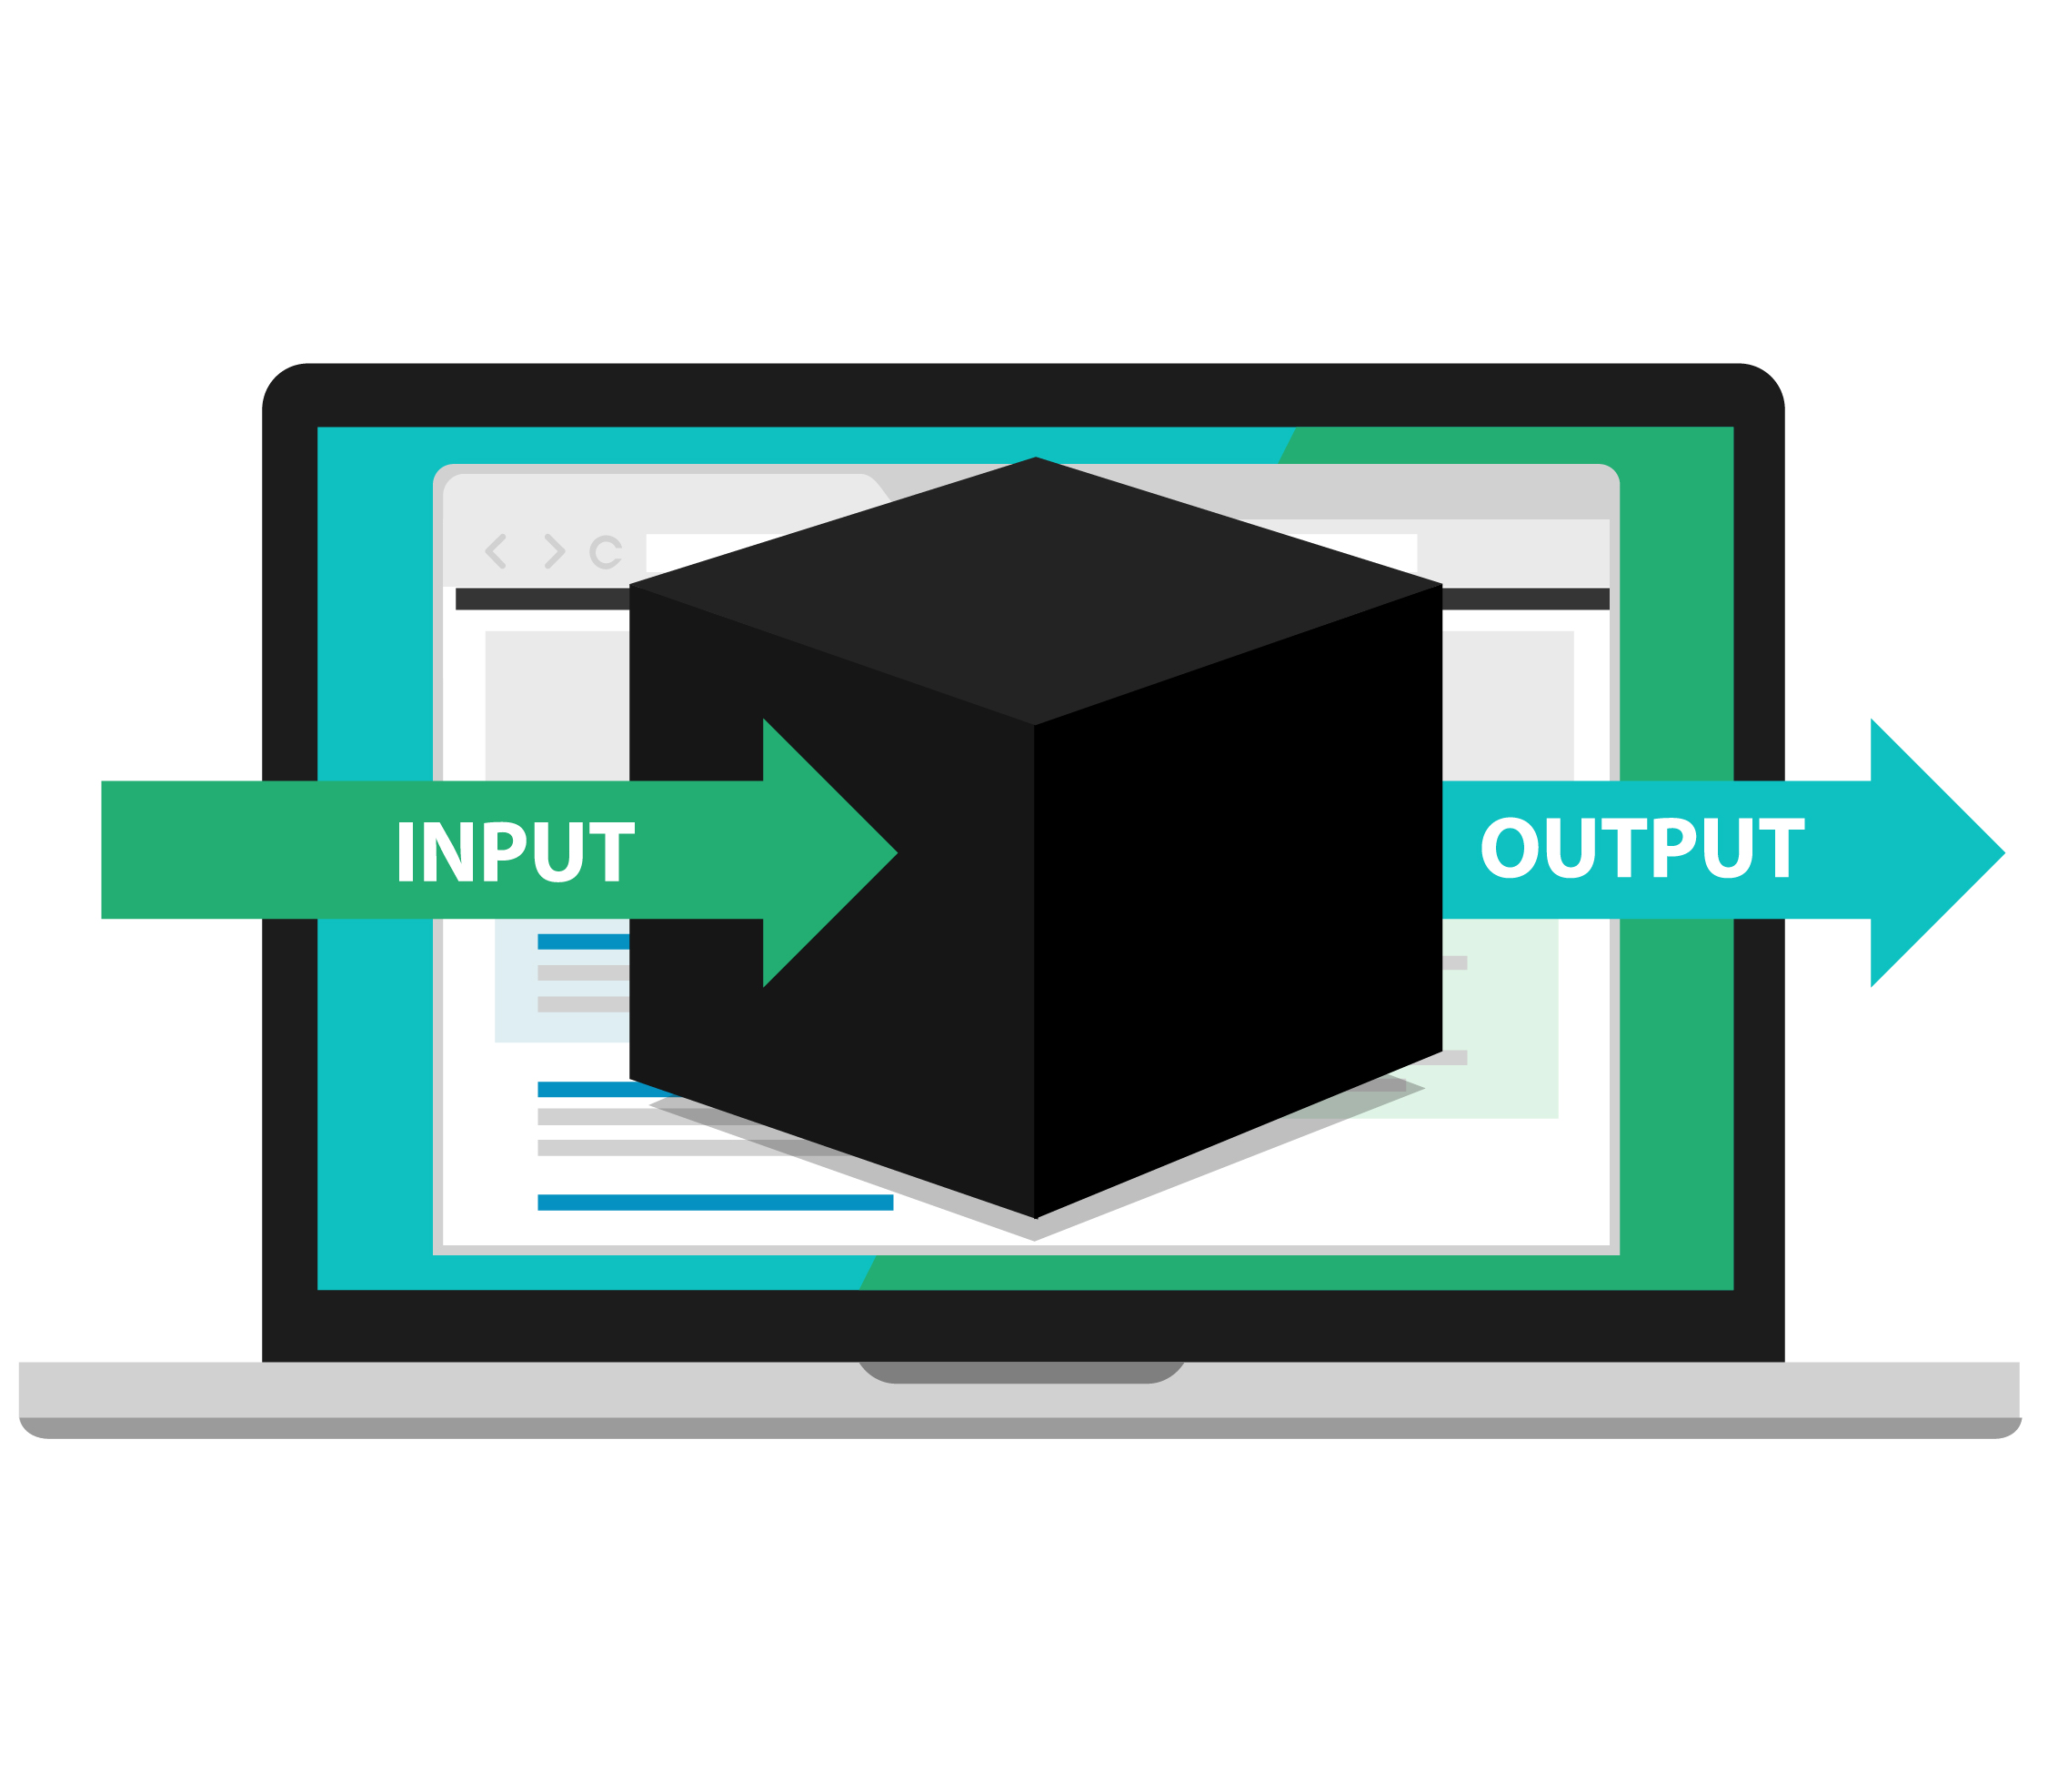
Black-Box and White-Box Testing
Black-Box Testing
While conducting black-box testing, the tester does not have any information on the internal working/implementation of the software system.
It focuses entirely on the behaviour of the software from the user perspective.
It can be performed at every level of software testing, for example, unit, integration, system and acceptance testing.
Types of black-box testing:
Manual testing
Automation testing

Slide 84
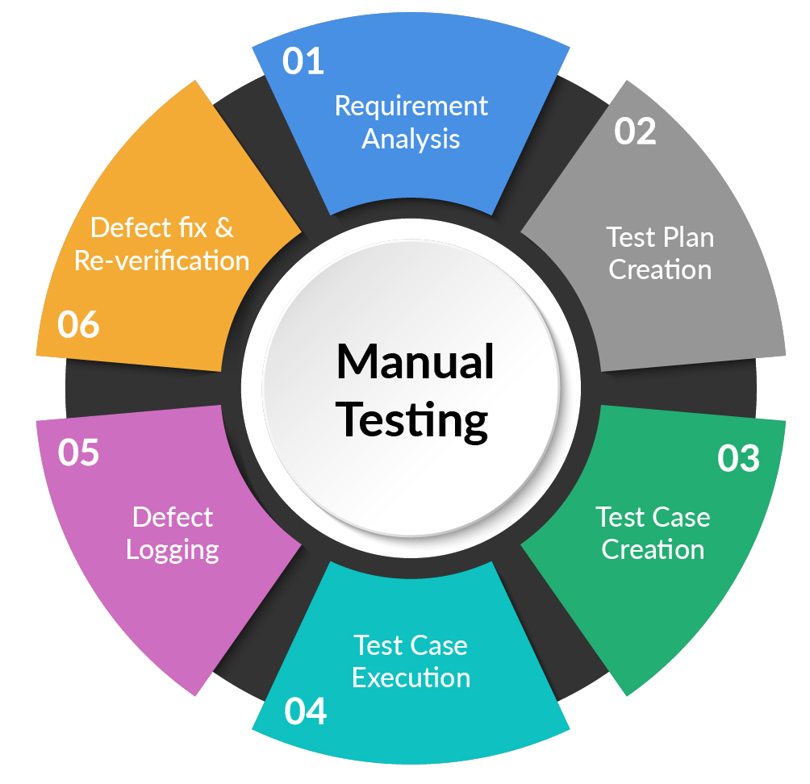
Black-Box Testing
Manual Testing
Manual testing is a process of manually detecting bugs and defects in a software program.
In this testing, the tester performs the end-user tasks manually and verifies whether all the features of the program are functioning as expected or not.

Slide 85
Black-Box Testing
UI Automation Testing
Automation testing is the practice of running tests automatically, managing test data and utilising results to improve the quality of software.
Criteria for automation:
Repeatable
Determinant
Types of automation tests:
Code analysis
Unit tests
Integration tests (UI/Mobile/API)
Automated acceptance tests
Regression tests
Smoke tests

Slide 86
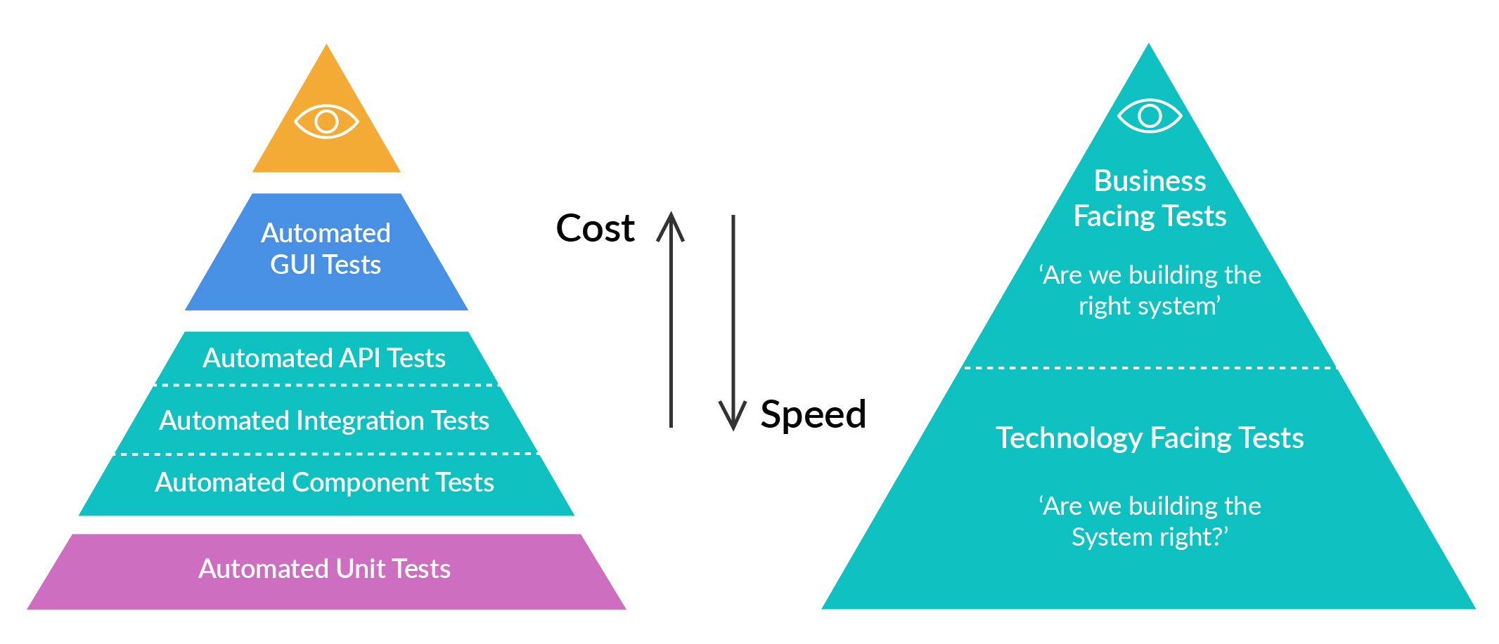
Black-Box Testing
Automation Testing
?

Slide 87
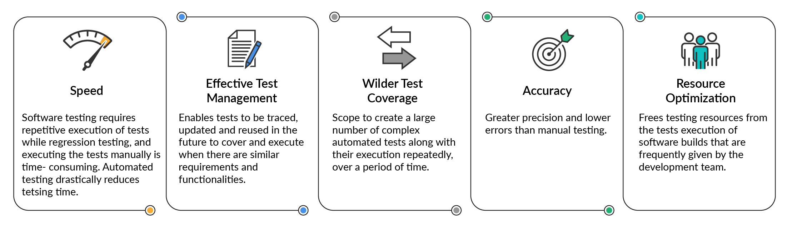
Black-Box Testing
Advantages of Automation Testing
Optimisation

Slide 88
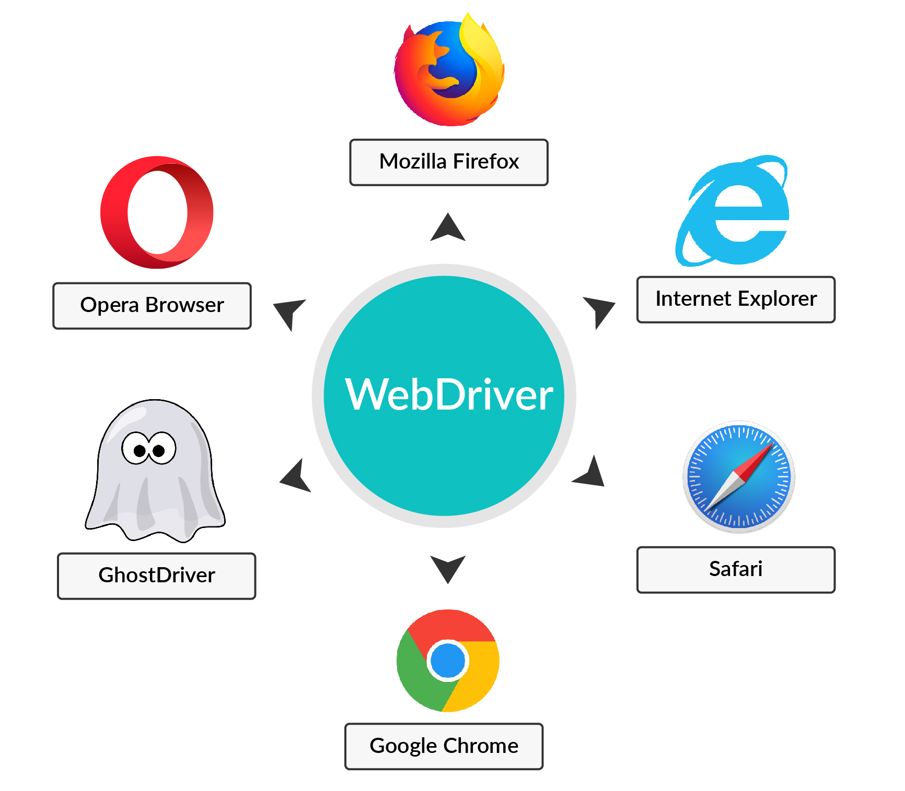
Black-Box Testing
Tools and Techs Used for Automation Testing
There are multiple tools and technologies that are used for writing automation scripts for software testing. The tools and technologies that we will be looking at in detail are:
Selenium WebDriver
RestAssured Framework
TestNG
Maven

Slide 89
Black-Box Testing
Advantages & Disadvantages
Advantages:
Well suited and efficient for large code segments as user sticks to functionality only.
Code access is not at all required.
Clearly separates the user's perspective from the developer's perspective through visibly defined roles within the application.
Large numbers of moderately skilled testers can test the application without any knowledge of internal implementation.
Disadvantages:
Limited coverage, since a selected number of test scenarios will be executed.
Inefficient testing, since a tester has limited knowledge about an application and this leads to more bugs at inner level of implementation
Blind coverage, as the tester cannot target specific code segments or error-prone areas.
The test cases are difficult to design in this case

Slide 90
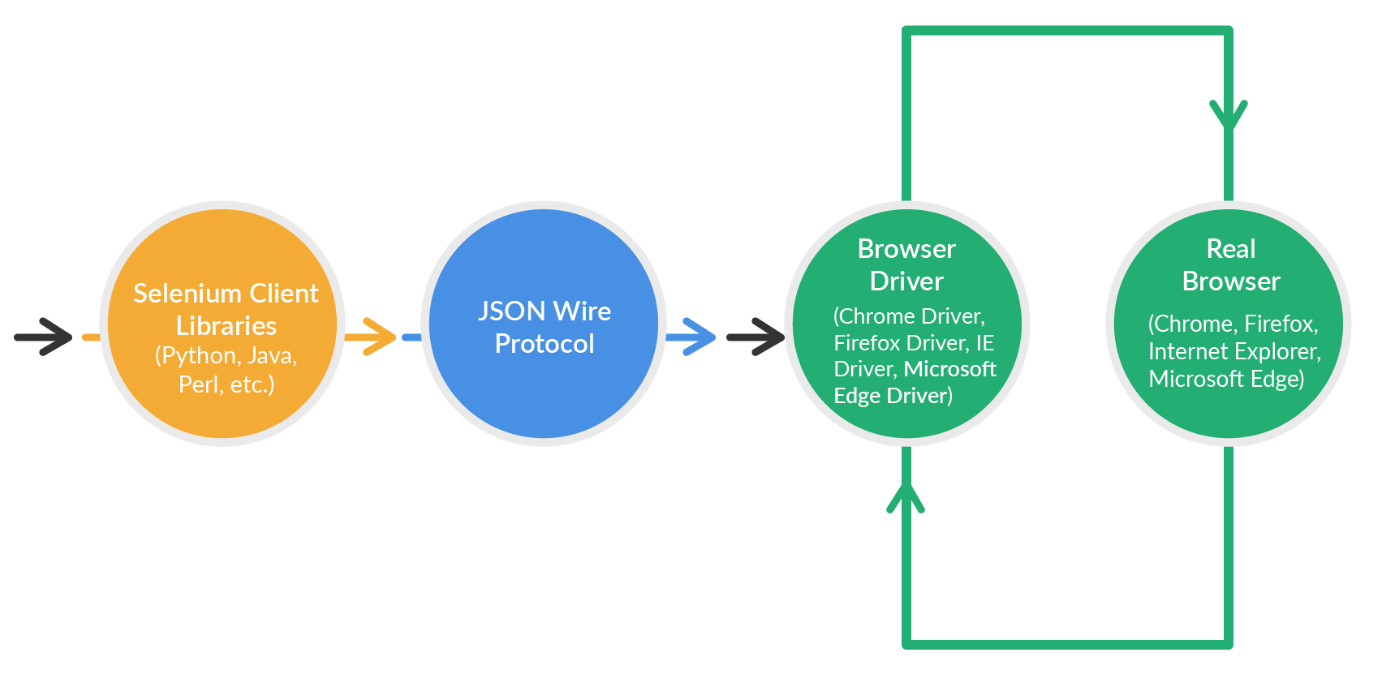
Tools and Techs Used for Automation Testing
Selenium WebDriver Architecture - Web UI Automation

Slide 91
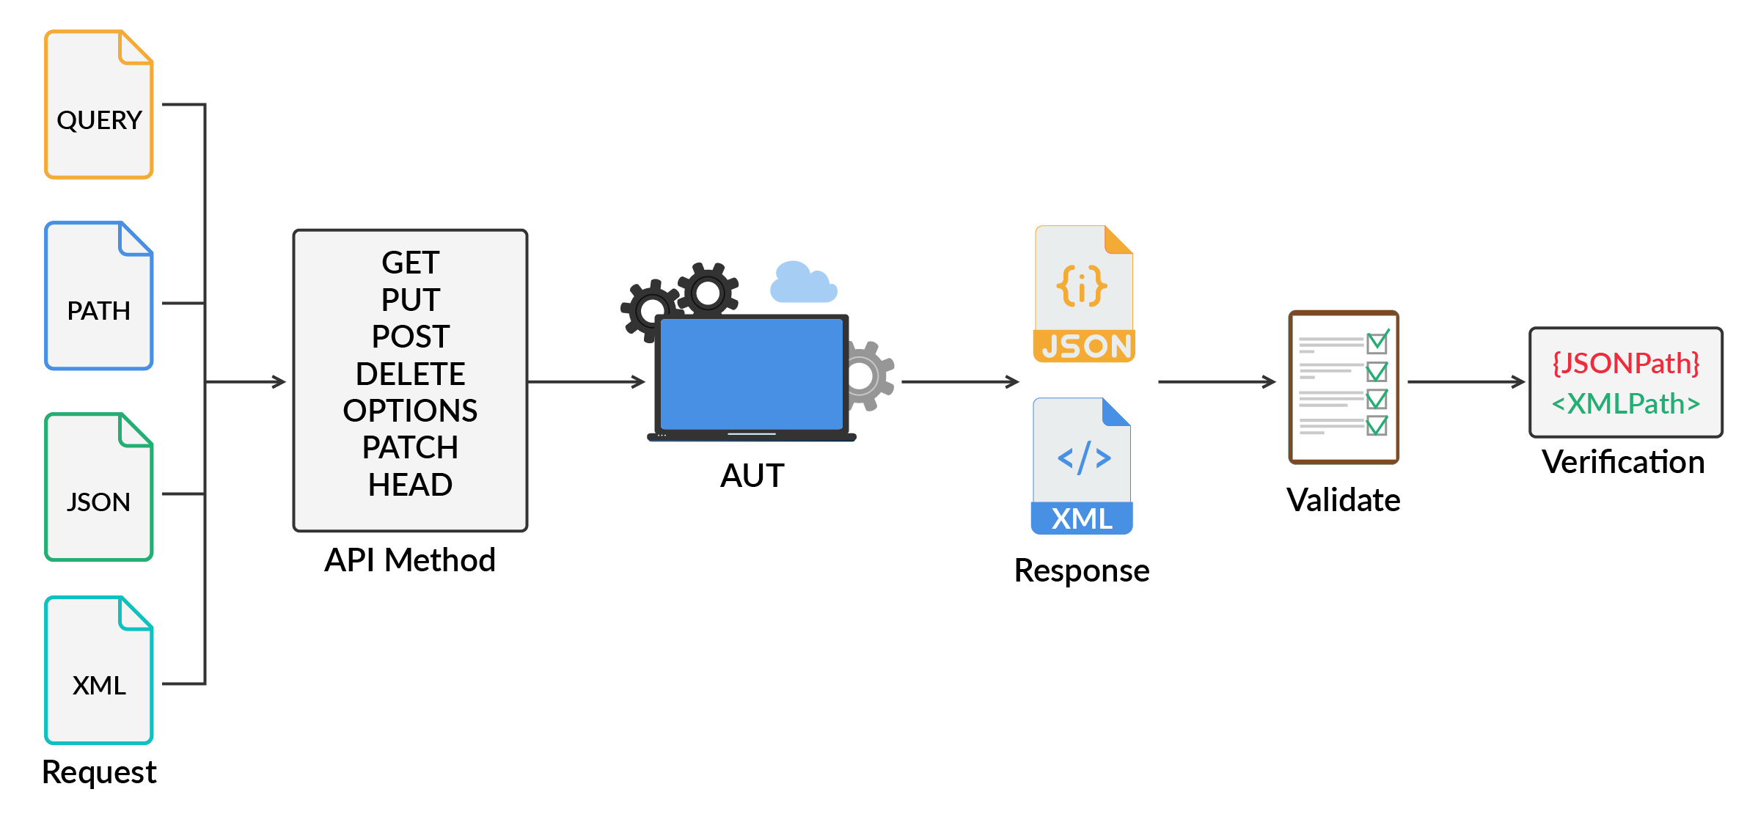
RestAssured Framework - API Testing

Slide 92
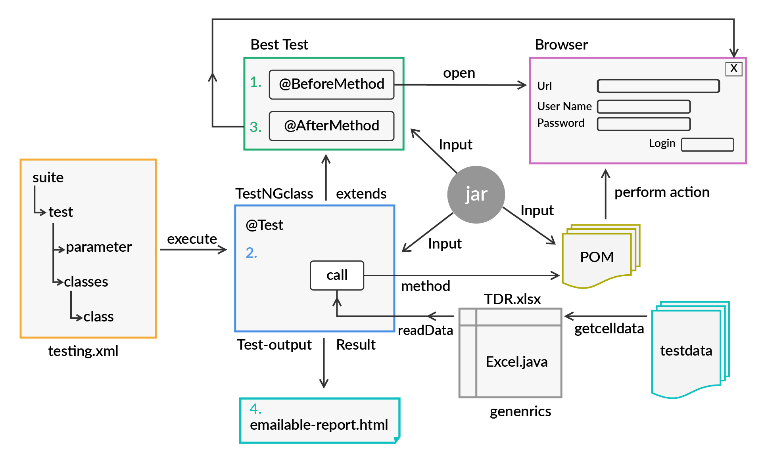
TestNG

Slide 93
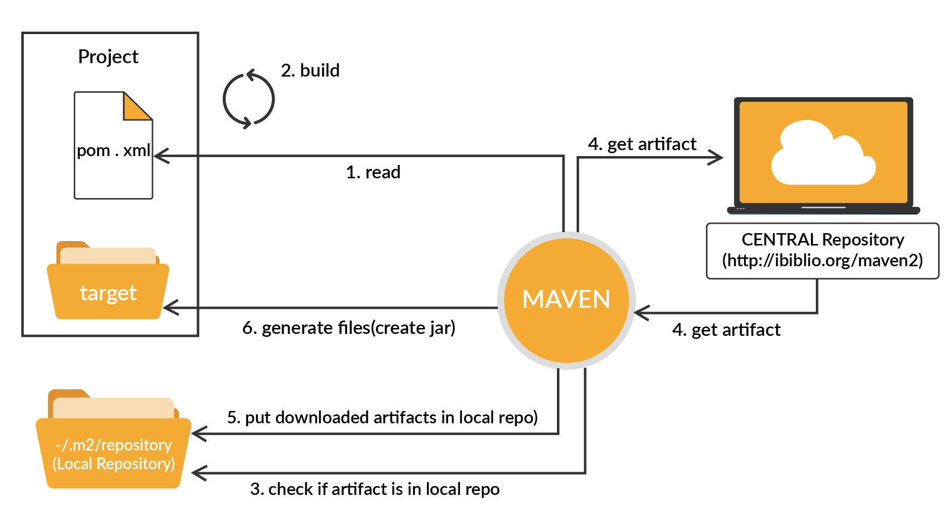
Maven

Slide 94
Poll 9 (15 Sec)
What of the following items can you automate?
GUI
Regression test suite
Smoke/Sanity test suite
All of the above
Practice in teams of 4 students
Industry expert mentoring to learn better
Get personalised feedback for improvements

Slide 95
Poll 9 (15 Sec)
What of the following items can you automate?
GUI
Regression test suite
Smoke/Sanity test suite
All of the above
Practice in teams of 4 students
Industry expert mentoring to learn better
Get personalised feedback for improvements

Slide 96
Test Plan

Slide 97
Test Plan
Test plan is an elaborate document that describes the strategy of a test that is to be conducted, the objectives of the test, the schedule and estimation of the test, and deliverables, as well as resources required for performing any kind of software testing. It helps us determine the effort that is required to assess the quality of the application being tested.
Analyse the Product
Formulate a Test Strategy
Define Test Objectives
Plan Test Environment
Plan Resources
Define Test Criteria
Schedule and Estimation
Determine Test Deliverables
For a sample test plan, you can go here.

Slide 98
Hands-On Exercise 2 (2 mins)
Design a test plan for zomato.com (user purchase journey for online food ordering from a restaurant)
For the test plan, you can go here.

Slide 99
Test Cases

Slide 100
Test Cases
A test case is a collection of actions that are performed for verifying a specific feature or functionality of a software application. A test case comprises of steps, test data, and pre-conditions and post-conditions, which are developed for a particular test scenario for verifying any requirements of the application under test
A test case includes specific variables or conditions, which can be used by a tester to compare the expected and the actual result, in order to decide whether or not a software is working according to the customers’ requirements.
A test case usually contains:
A Title,
Description,
Test steps to reproduce,
Expected result,
Actual result and
Priority.

Slide 101
Types of Test Cases
Test cases are the following different types:
Functional test cases
Performance test cases
Integration test cases
UAT test cases
API/back-end test cases:
Positive test cases
Negative test cases
Edge test cases

Slide 102
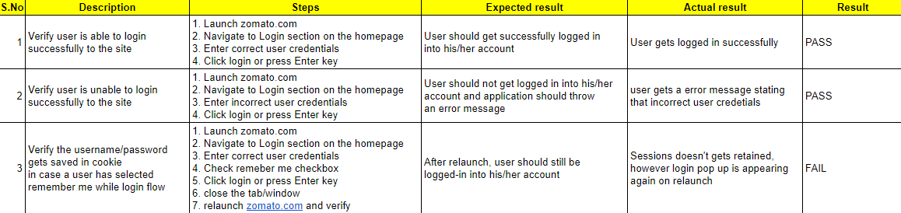
Sample Test Cases
For the test case, you can go here.

Slide 103
Hands-On Exercise 2 (5 mins)
Note down 3 positive, 1 negative and 1 edge test case in proper format for the following user flow of a restaurant search and online food ordering website:
1. Launch www.zomato.com
2. Search for a restaurant
3. Choose a location
4. View search results
5. Click on the first listed restaurant
6. Click on the ‘Add Review’ button
You can see a sample answer here.

Slide 104
Hands-On Exercise 3 (2 mins)
Note down 1 positive, 1 negative and 1 edge test case for the following public api at zomato.com
{Launch https://developers.zomato.com/documentation#!/common/categories}
This API is offered by Zomato to get a list of categories. A list of all restaurants categorised under a particular restaurant type can be obtained using the Search API with Category IDs as inputs.
CURL:
curl -X GET --header "Accept: application/json"
--header "user-key: 7b8c2002a92c21109f1dfd2808ea50e1" "https://developers.zomato.com/api/v2.1/categories"
Model:
[
{
"category_id": "3",
"category_name": "Nightlife"
}
]
Success response:
{
"categories": [
{
"categories": {
"id": 1,
"name": "Delivery"
}
},
{
"categories": {
"id": 2,
"name": "Dine-out"
}
}
]
}
You can see a sample answer here.

Slide 105
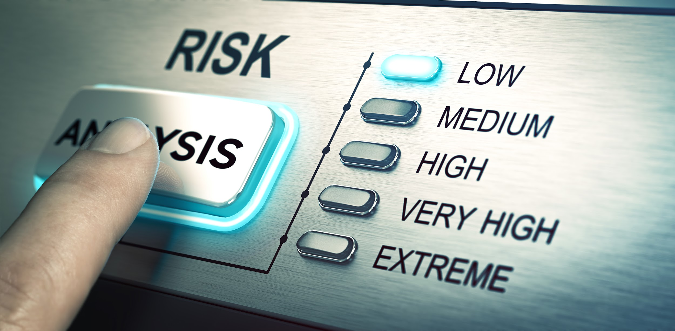
Severity and Priority

Slide 106
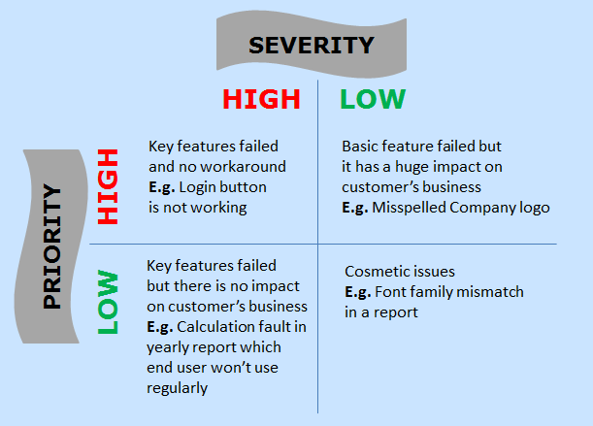
Severity - Priority
Severity refers to the extent to which a certain defect can impact an application. It is used to indicate the implication for and the impact of a defect on a software/application’s functionality.
Priority is a parameter that is used to determine the order in which defects should be fixed. A defect with higher priority should be fixed first.

Slide 107
Poll 10 (15 Sec)
If company name is misspelled on the home page of a website. This statement belongs to which of the following bucket?
High Priority, Low Severity
High Severity, Low Priority
Low Priority, Low Severity
High Priority, High Severity
Practice in teams of 4 students
Industry expert mentoring to learn better
Get personalised feedback for improvements

Slide 108
Poll 10 (Answer)
If company name is misspelled on the home page of a website.
This statement belongs to which of the following bucket?
High Priority, Low Severity
High Severity, Low Priority
Low Priority, Low Severity
High Priority, High Severity
Practice in teams of 4 students
Industry expert mentoring to learn better
Get personalised feedback for improvements

Slide 109

Bug Reporting

Slide 110
Bug Reporting
A bug report has device logs, various stack traces and other diagnostic information, which help with detecting and fixing bugs in software.
It consists of the following parameters:
Title
Environment
Steps to reproduce
Expected result
Actual result
Visual proof (screenshots, videos, text)
Severity/priority

Slide 111
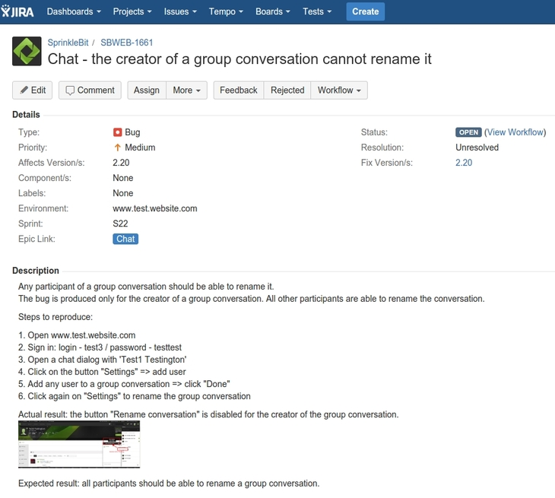
Bug Reporting Template

Slide 112
Hands-On Exercise 4 (3 mins)
Find a bug on https://www.zomato.com and document it in proper bug reporting format.
Description:
User lands on a blank page
Steps to reproduce:
Launch zomato.com
Search for a restaurant in the i/p search text box
Verify the search result page
Verify that the user has landed on a blank page
Actual result:
User lands on a blank page
Expected result:
User should land on a page with proper content
Screenshot:
link to screenshot/screen-recording
Logs: curl 'https://www.googletagmanager.com/gtm.js?id=GTM-N5JXFL' \
-H 'authority: www.googletagmanager.com' \
-H 'user-agent: Mozilla/5.0 (Macintosh; Intel Mac OS X 10_15_5) AppleWebKit/537.36 (KHTML, like Gecko) Chrome/84.0.4147.105 Safari/537.36' \
-H 'accept: */*' \
-H 'sec-fetch-site: cross-site' \
-H 'sec-fetch-mode: no-cors' \
-H 'sec-fetch-dest: script' \
-H 'referer: https://www.zomato.com/privy/find-a-restaurant' \
-H 'accept-language: en-US,en;q=0.9' \
--compressed
throws 404.

Slide 113
Project Work (20 mins)
Online Food Ordering Website
Let’s talk about the components that we should automate from a UI perspective, and for API testing and performance testing
Define a bug of high priority and low severity with respect to Zomato as an application
Define a bug of high severity and low priority with respect to Zomato as an application
You can refer to the solution here.

Slide 114
Doubt Clearing (5 mins)

Slide 115
Key Takeaways
You learnt that software testing is crucial when it comes to developing an error-free software product.
You learnt about different methodologies of software testing and the application of each methodology in the entire software testing life cycle.
You learnt about different types of white-box and black-box testing methods.
You learnt how to write a test plan.
ou learnt how to write test cases.

Slide 116
Tasks to Complete After Today’s Session
MCQs
Project - Checkpoint 1

Slide 117
Next Class
More about Selenium WebDriver
UI Automation using Selenium WebDriver
API Automation

Slide 118
#RahoAmbitious
Thank You!

